Slide 1
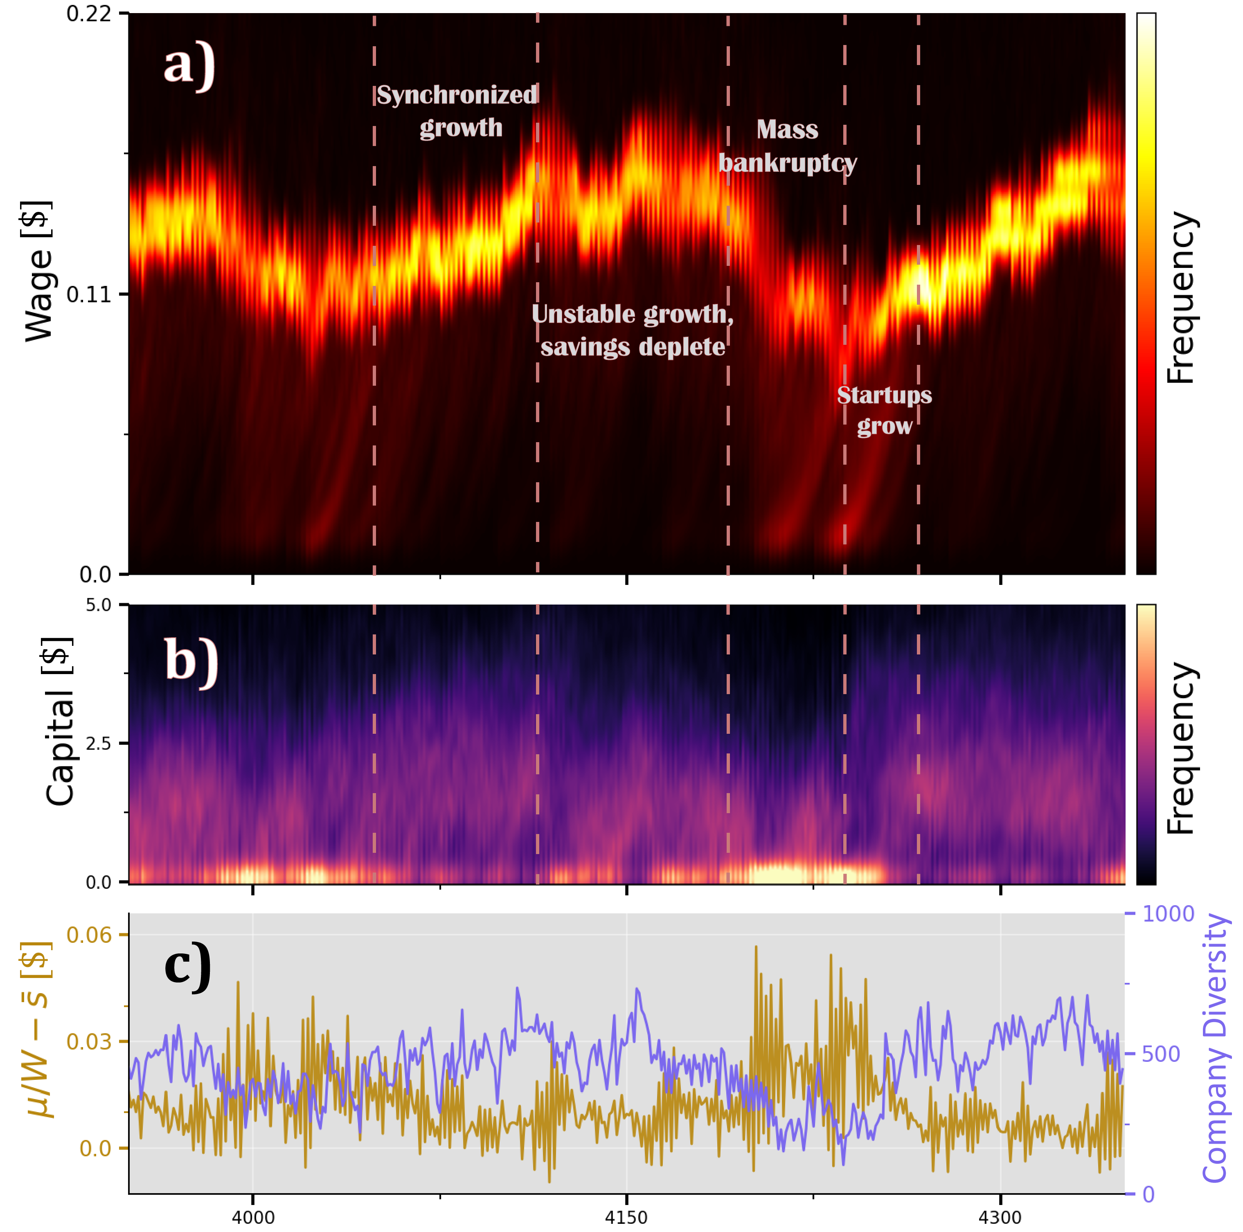
Emergent Inflation-Deflation Cycles from Minimalistic Wage Dynamics
Or: What happens when a physicist claims to know better than the economists, without really knowing economics.

Slide 2
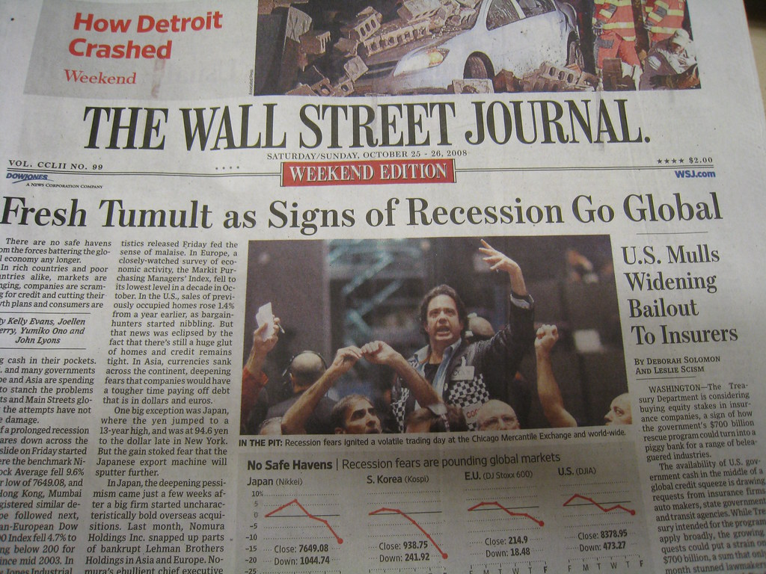
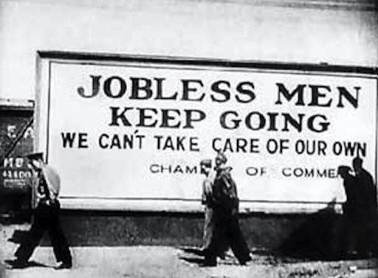
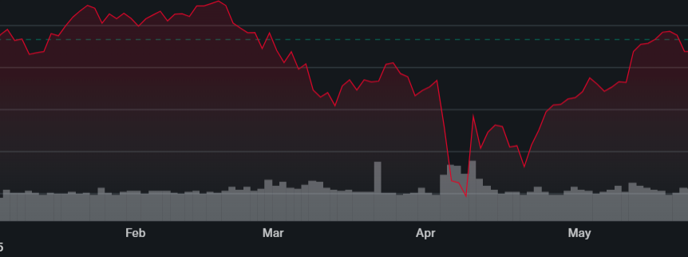
Sometimes, the economy goes bad

Slide 3
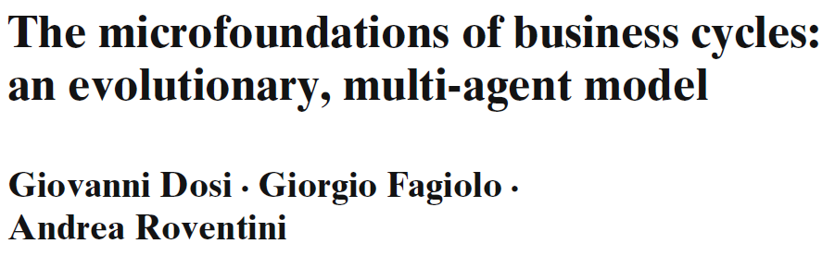
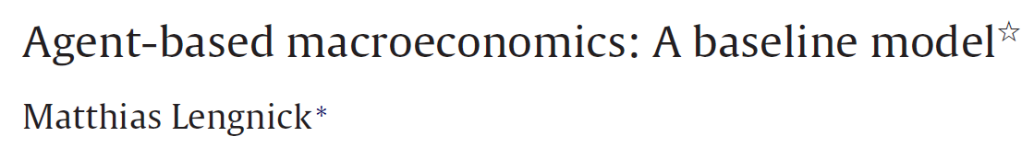
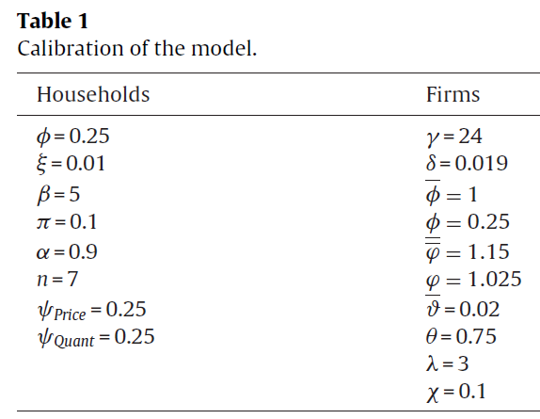
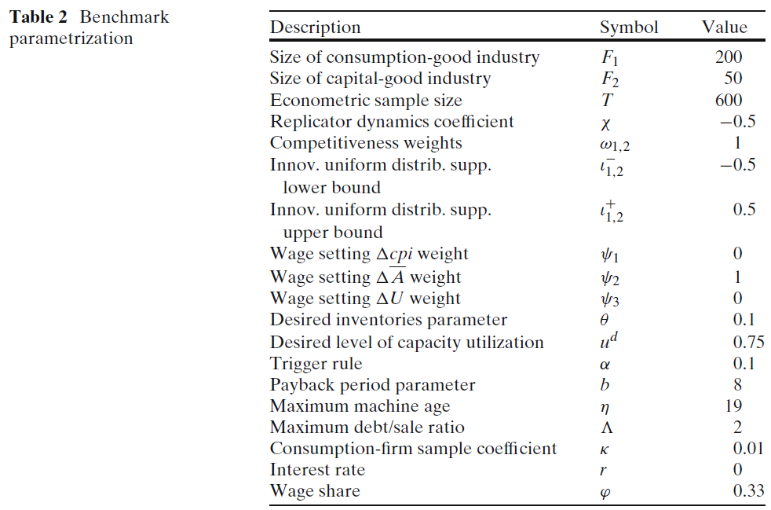
So, what are the economists doing to prevent recessions?

Slide 4
Goal:
Describe the business cycle with less complexity than economists,
while still getting reasonable results

Slide 5
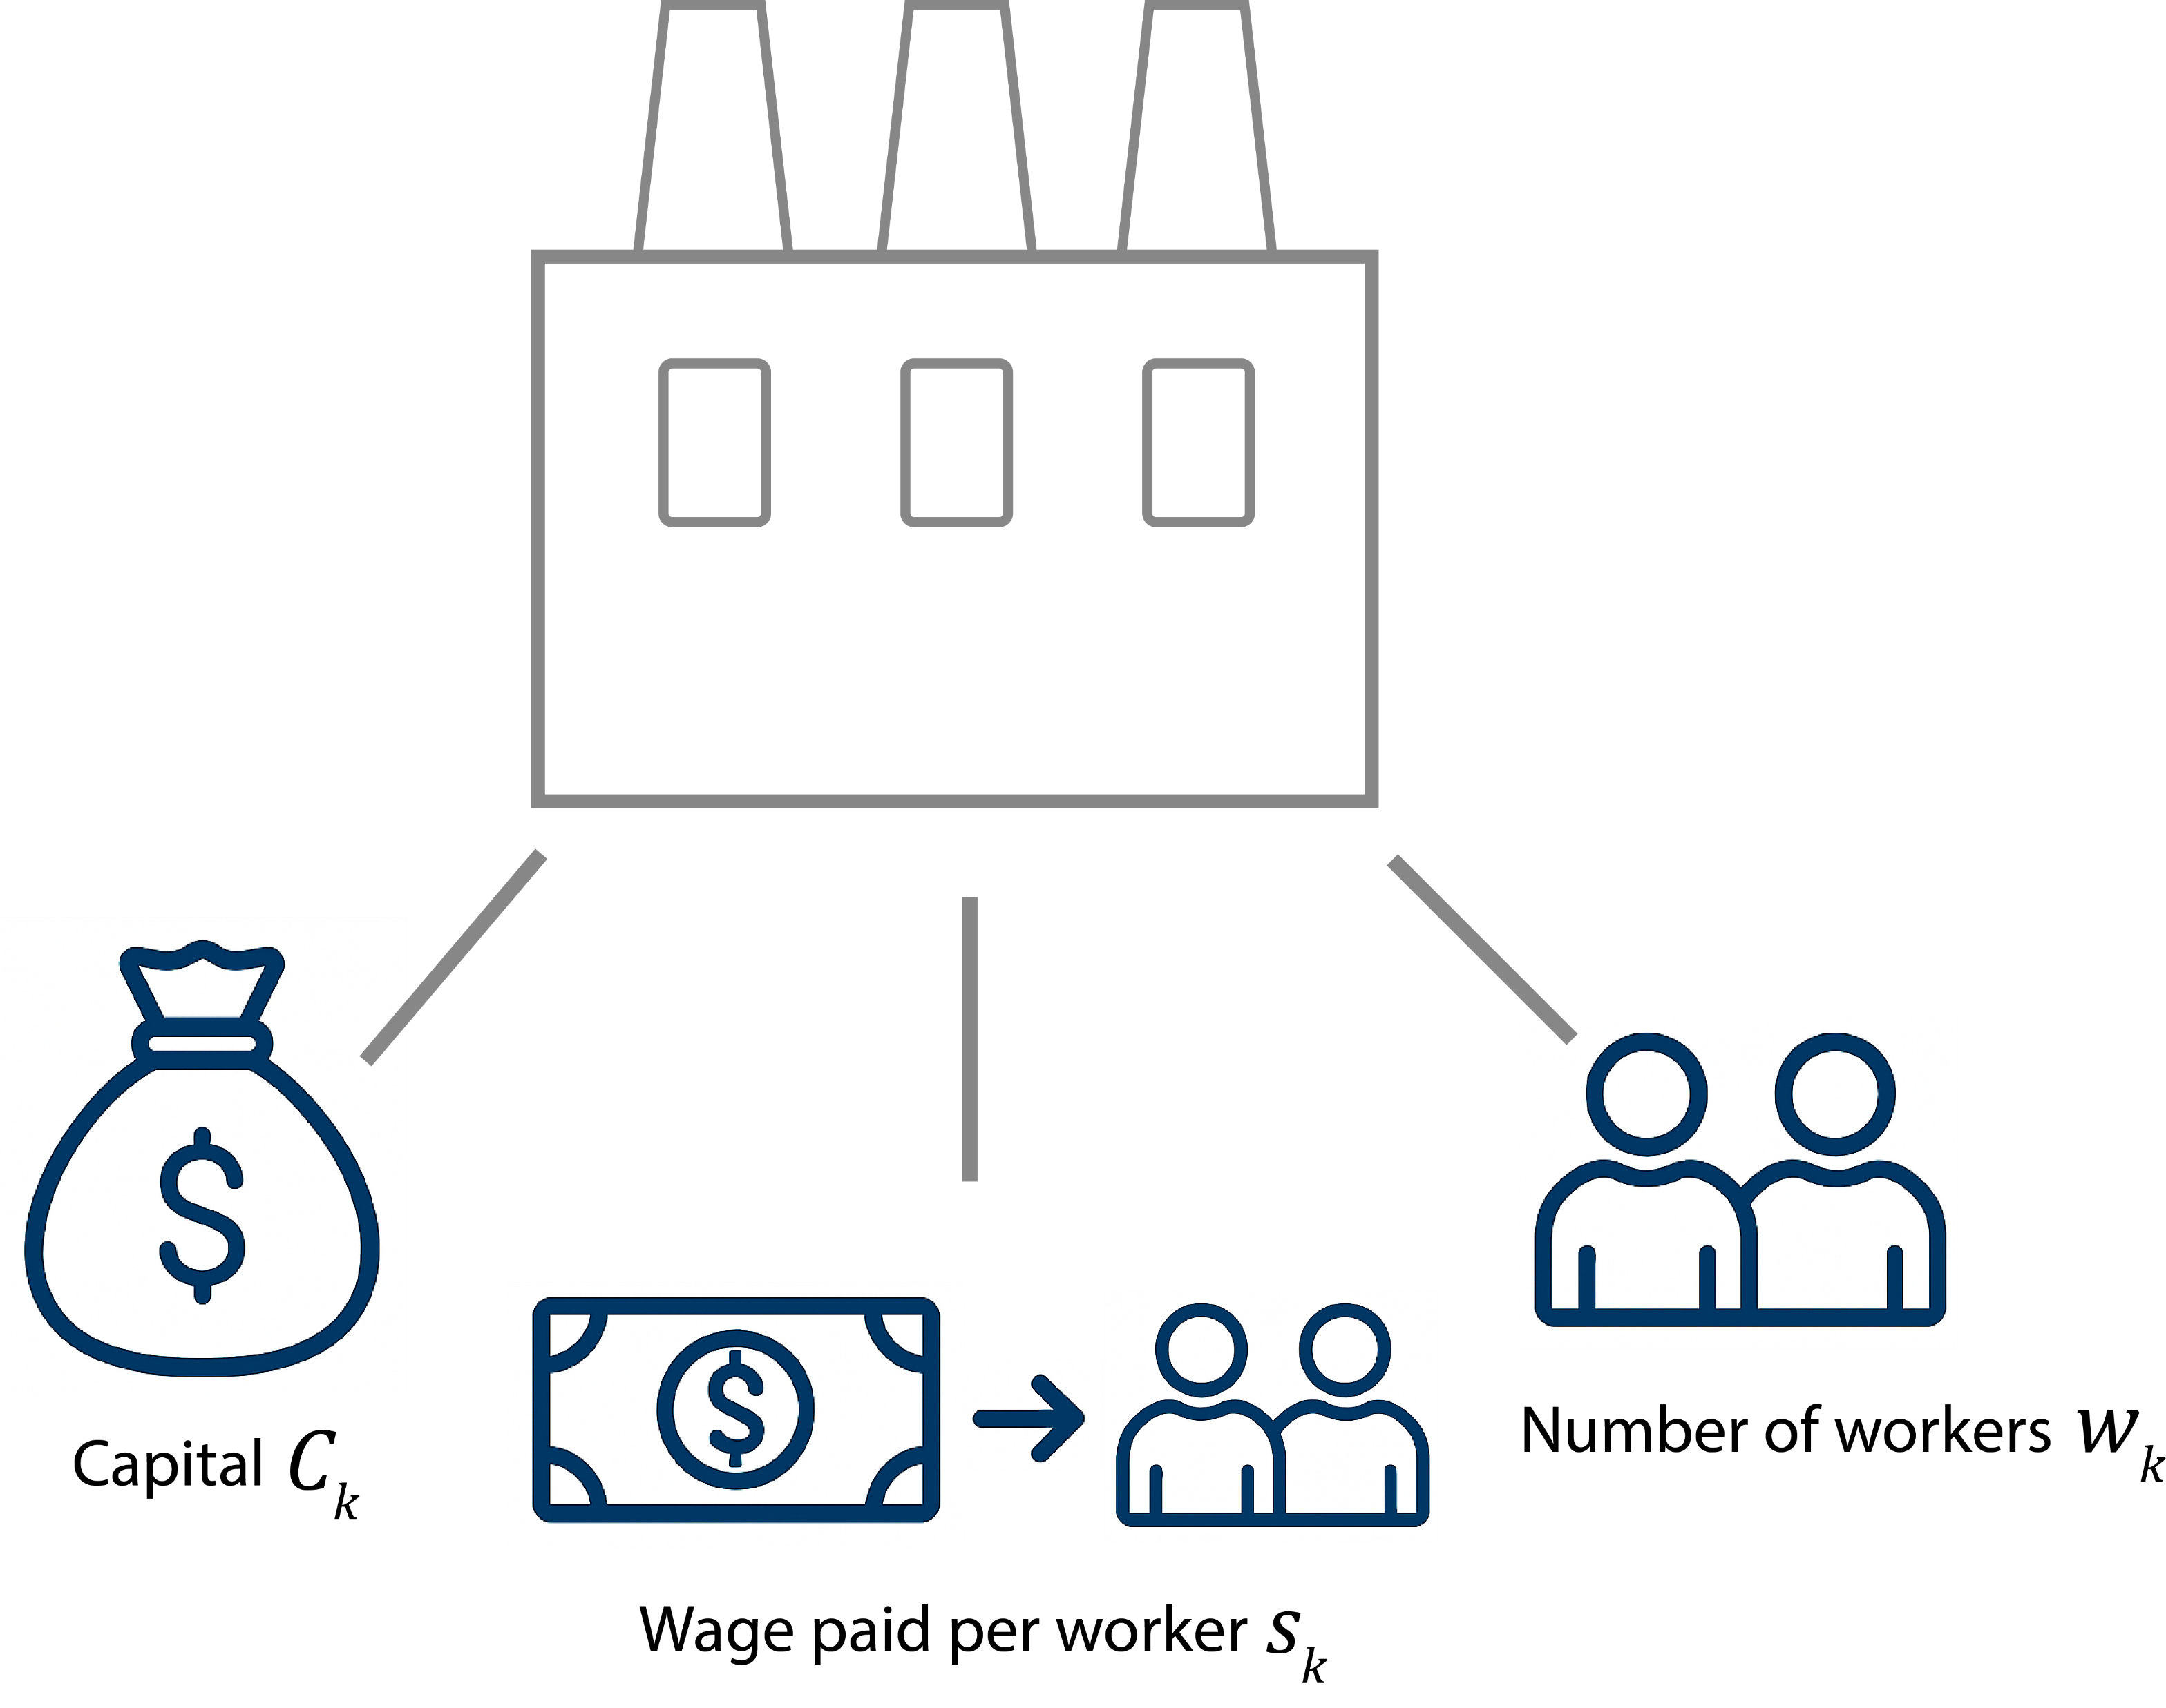
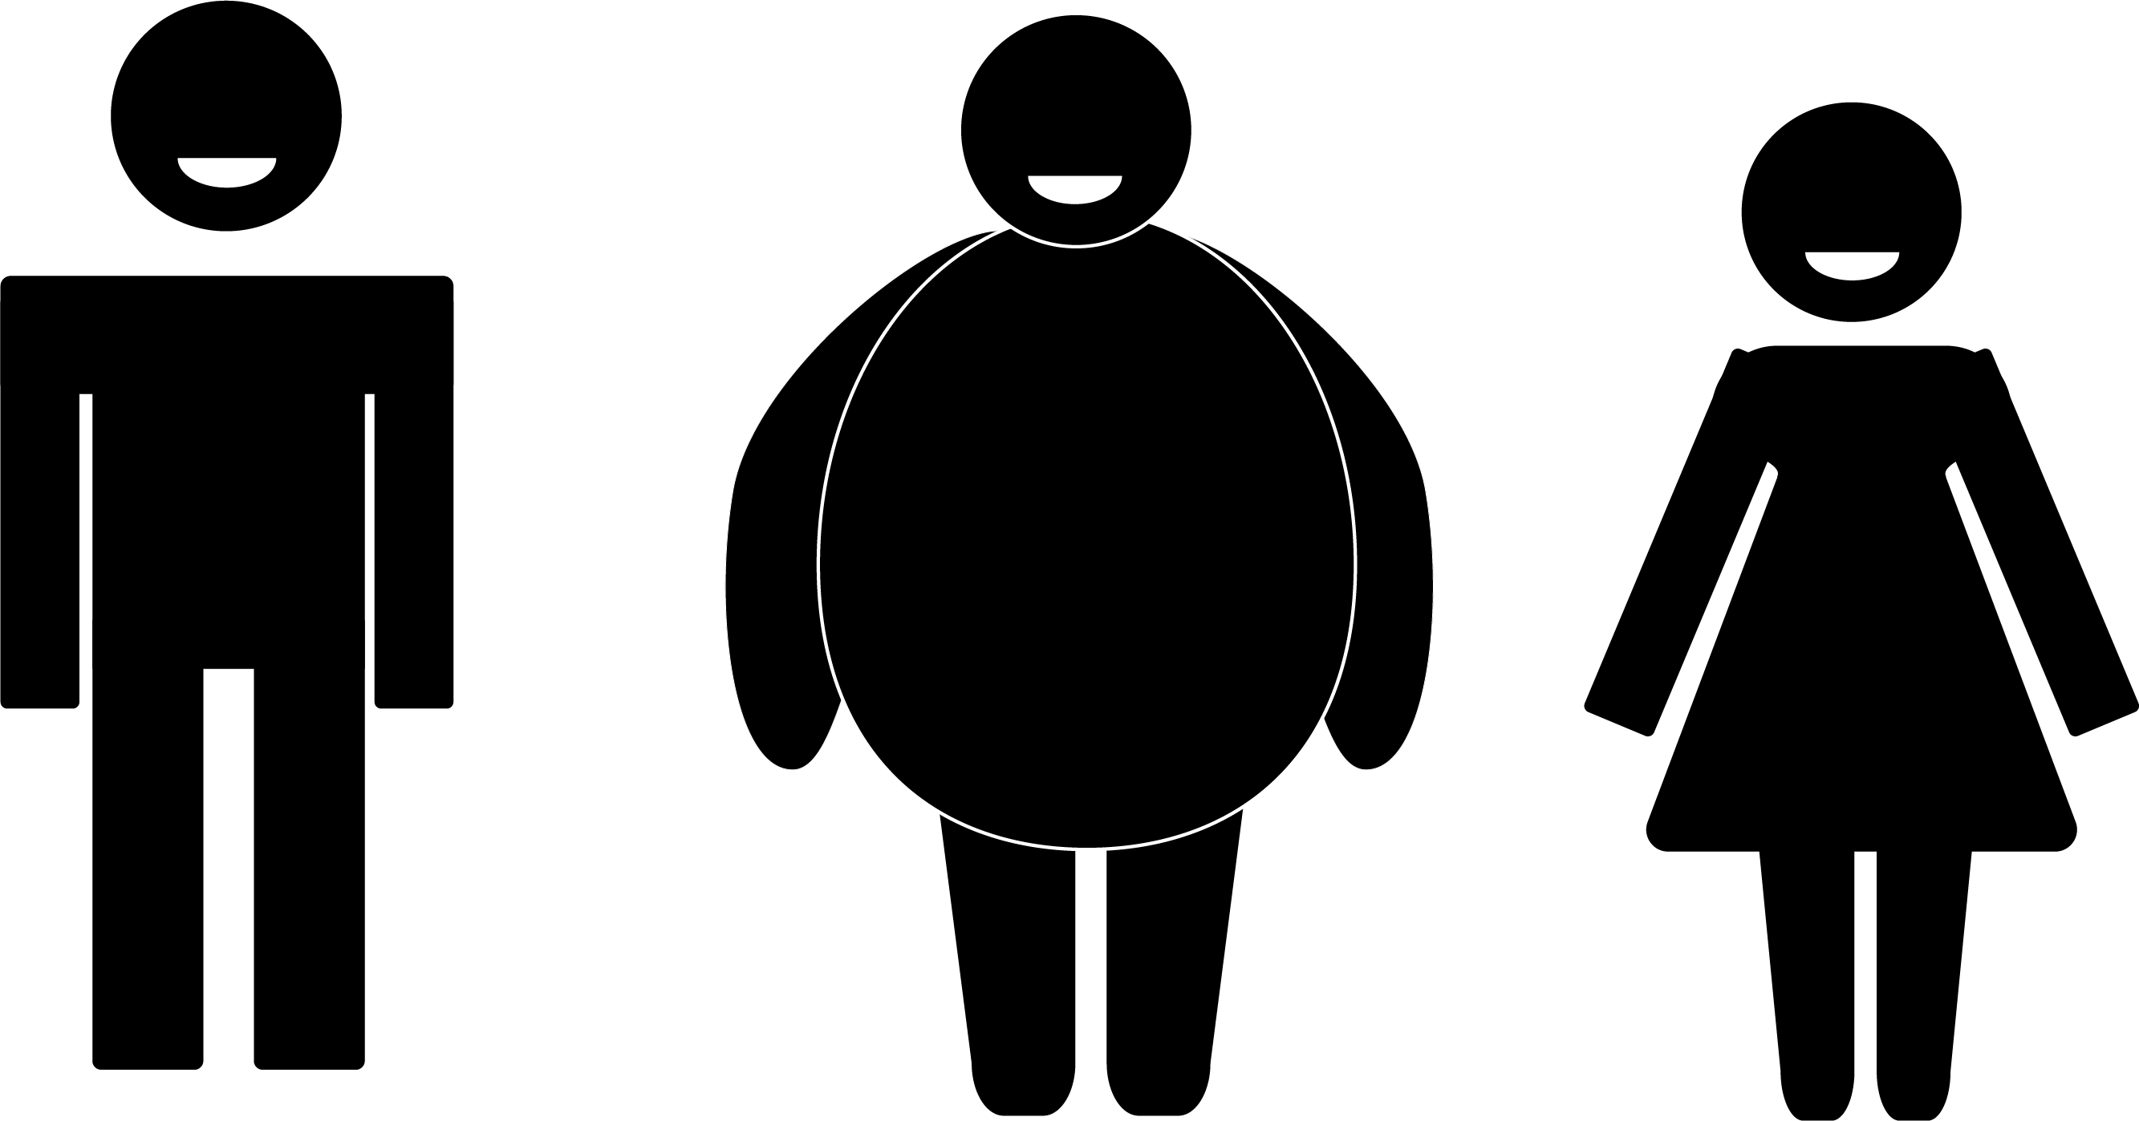
Let’s go simple
N Companies
W Workers

Slide 6
A day in the life of two model workers
Alice
Bob

Slide 7

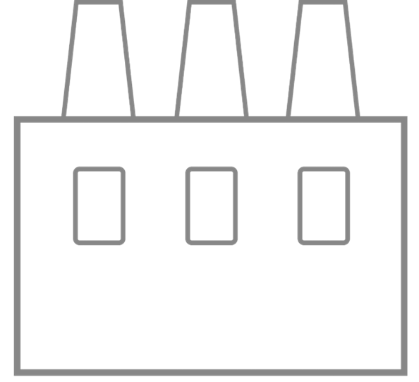
They choose a random workplace

Slide 9

Companies enter the Transaction Lottery
The company Alice works for wins!

Slide 10


Alice produces one unit of output for the company…

Slide 11
Alice produces one unit of output for the company…
$
… And is paid for the work done

Slide 12

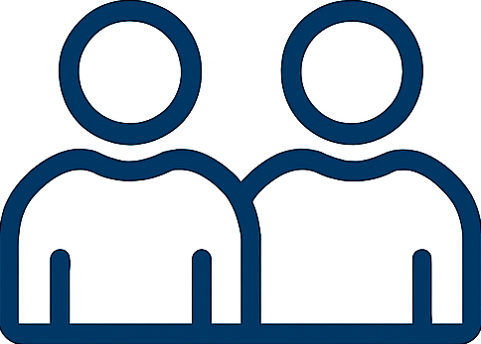
The company sells Alice’s output
$
Consumers

Slide 13
But what about Bob?
Unfortunately, his company lost the transaction lottery, and he spent his time doing nothing ☹

Slide 14

They go to back home

Slide 15
And the cycle repeats

Slide 16
However, we don’t care about Alice and (especially not) Bob
Alice
Bob

Slide 17
However, we don’t care about Alice and (especially not) Bob
We care about companies

Slide 20
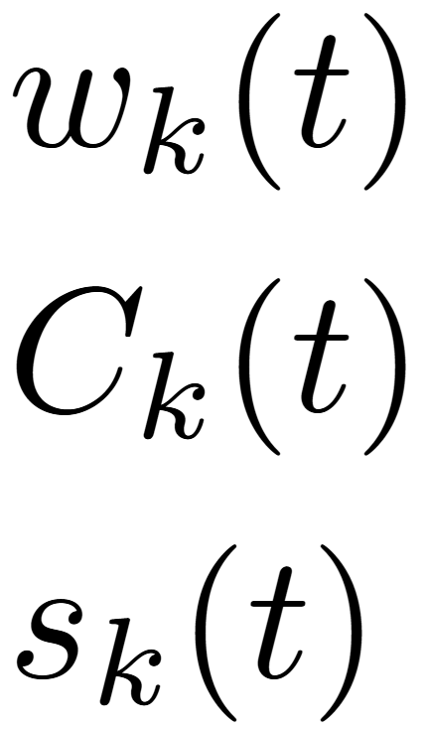

Slide 22
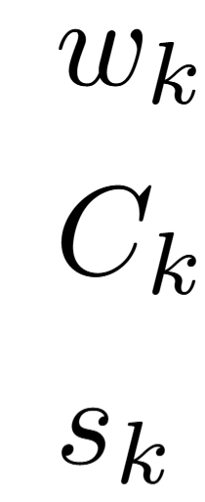
How are workers employed?

Slide 23
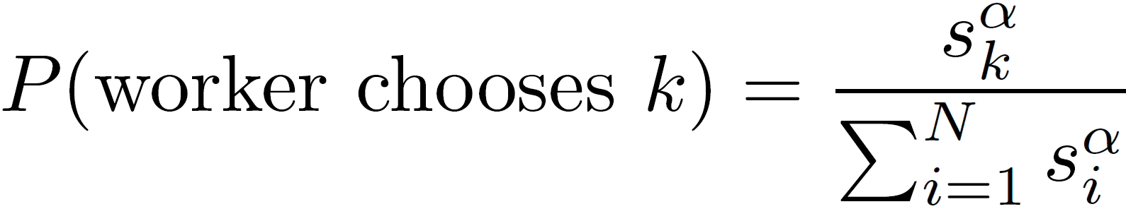

Slide 24
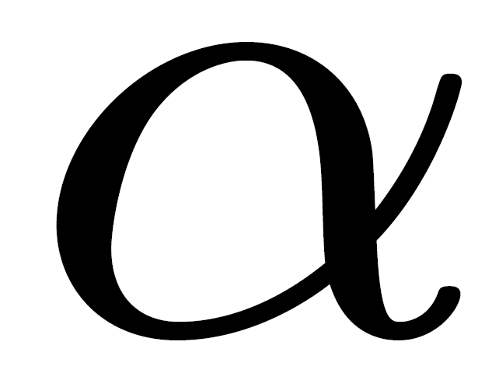
: Wage sensitivity parameter

Slide 25
How do companies make money?

Slide 26
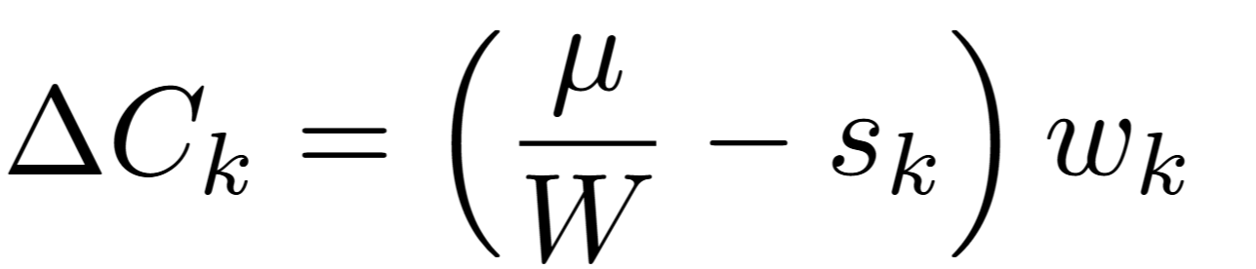

Slide 27
Pay worker

Slide 28
Pay worker
Sell unit produced

Slide 29
What’s this thing?
Pay worker
Sell unit produced

Slide 30
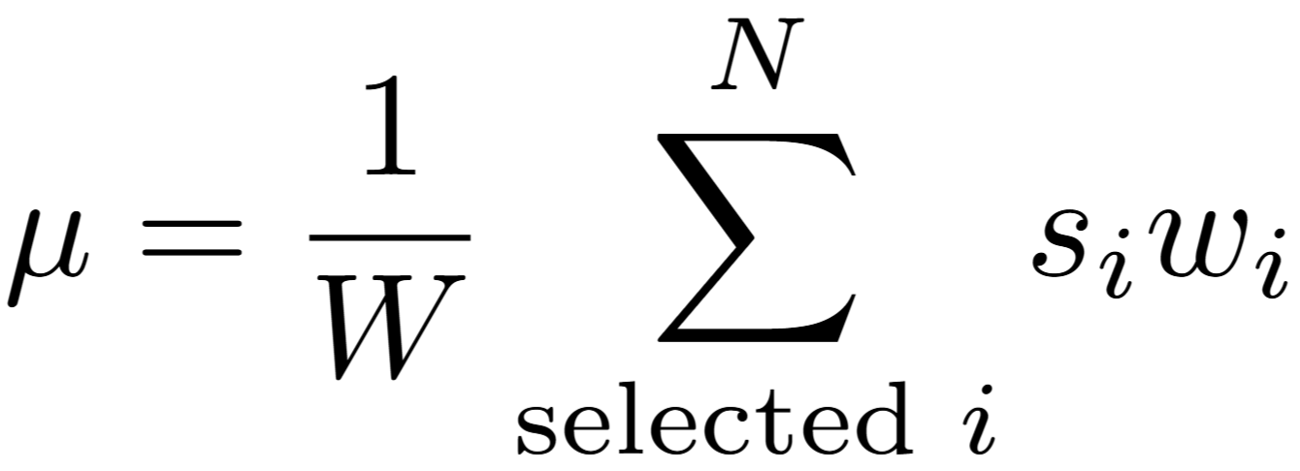
The company sells Alice’s output
$
Consumers
= Total wage paid
= Average worker’s money
= Price of products

Slide 31
The company sells Alice’s output
$
Consumers
= Total wage paid
= Average worker’s money
= Price of products

Slide 32
The company sells Alice’s output
$
Consumers
= Total wage paid
= Average worker’s money
= Price of products

Slide 33
Pay worker
Sell unit produced
… And thus, earn money equal to the average weighted wage

Slide 34
When do companies make a profit?

Slide 35
When do companies make a profit?

Slide 36
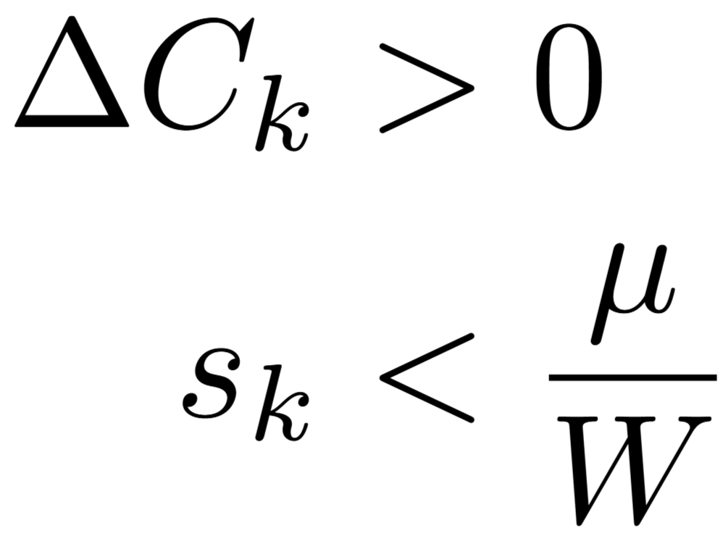
When do companies make a profit?

Slide 37
When do companies make a profit?

Slide 38
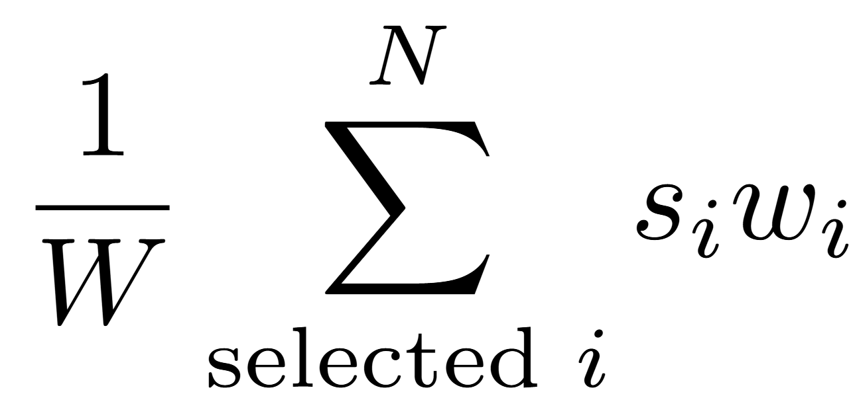
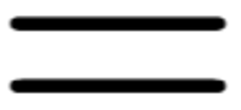
When do companies make a profit?

Slide 39
When do companies make a profit?
Large companies cause most companies to make a profit, yet that creates vulnerability to shocks

Slide 40
How are wages updated?

Slide 41
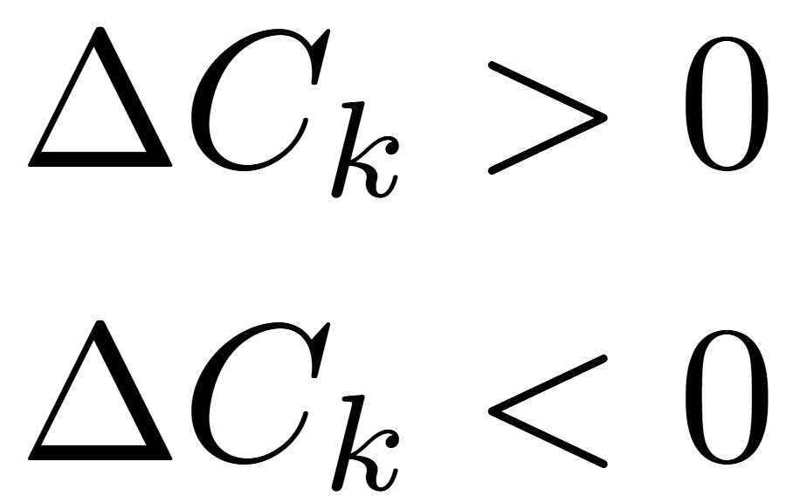
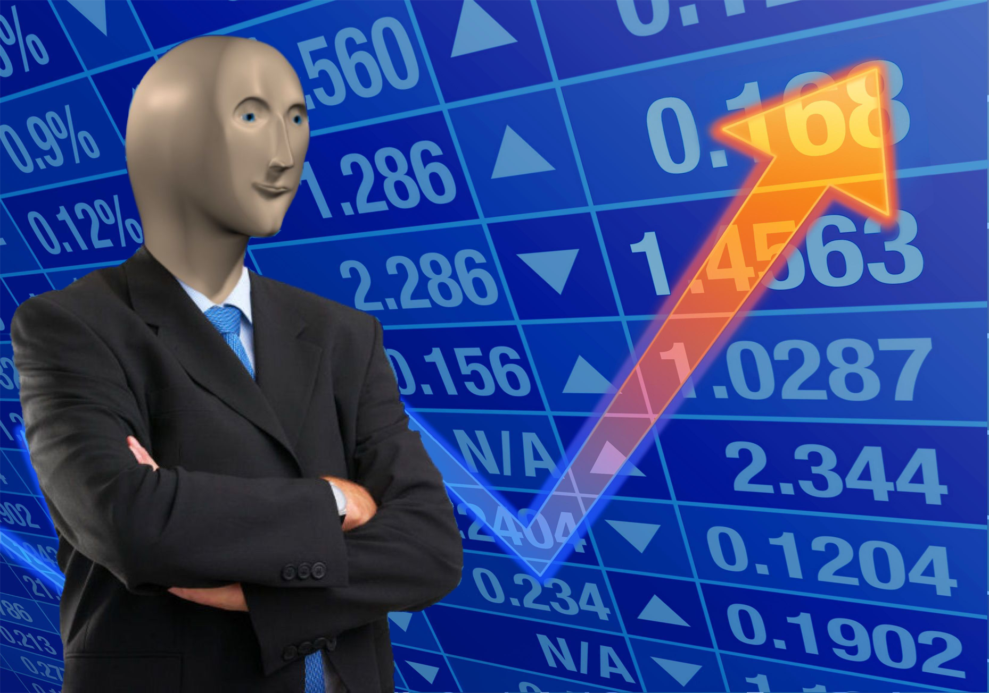

Slide 42
Want more workers to sell more

Slide 43
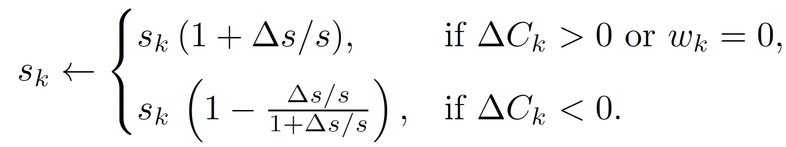
Want more workers to sell more

Slide 44
Want more workers to sell more
Update size parameter

Slide 45
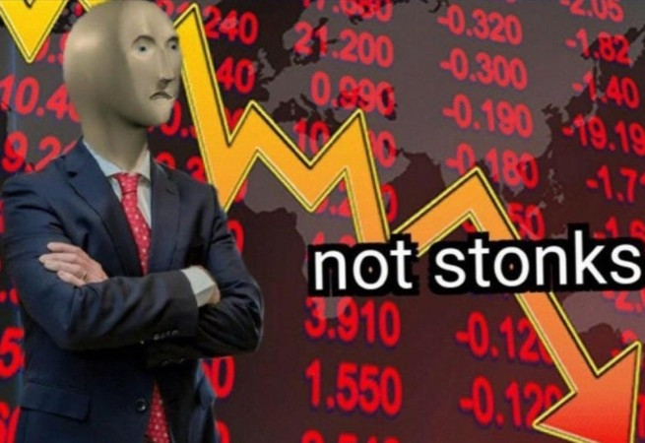

Slide 46
Want fewer workers to pay less in wages

Slide 47
Want fewer workers to pay less in wages

Slide 49
Zero worker companies also increase wages

Slide 50
Quick summary

Slide 54

The circle of (corporate) life
Company
Birth
Death

Slide 55
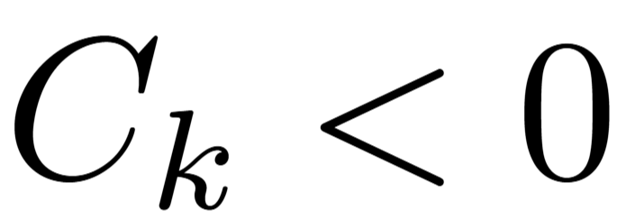
Company
Death

Slide 56
Birth
Death

Slide 57
Birth
Death
Startup company

Slide 58
Birth
Death
Startup company
= 0
= 0

Slide 59
Birth
Death
Startup company
= 0
= 0
= Copy a profitable company

Slide 60
Birth
Death
Startup company
= 0
= 0
= Copy a profitable company
Choose a company’s wage randomly

Slide 61
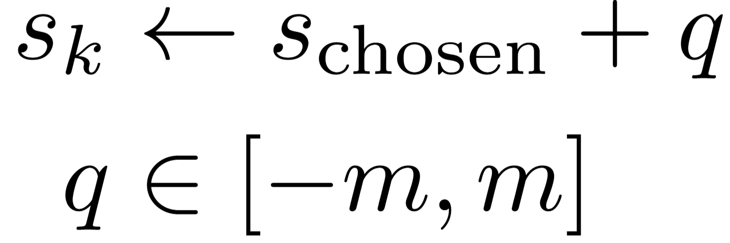
Birth
Death
Startup company
= 0
= 0
= Copy a profitable company
Choose a company’s wage randomly
Add noise

Slide 62
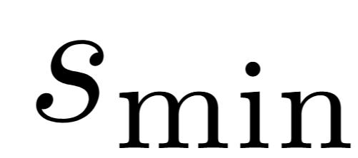
Birth
Death
Startup company
= 0
= 0
= Copy a profitable company
Choose a company’s wage randomly
Add noise
Enforce minimum wage

Slide 63
Birth
Death
Startup company
= 0
= 0
= Copy a profitable company
Choose a company’s wage randomly
Add noise
Parameters
Enforce minimum wage

Slide 64
Company
Birth
= 0
Because , a new company skips a transaction round

Slide 65
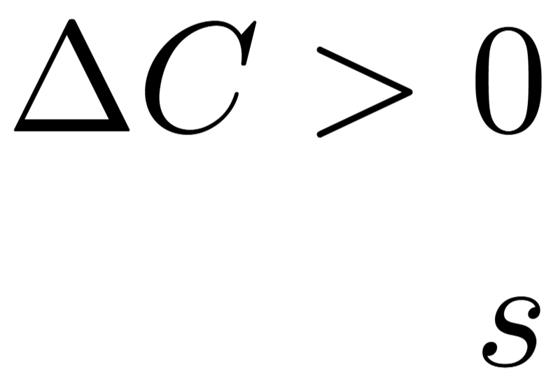
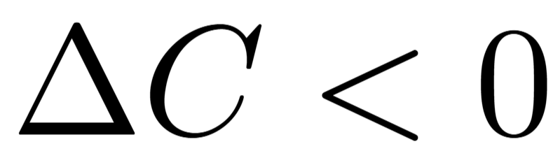
1
Startup company
1
2
2
N
N

Slide 66
1
Startup company
1
2
2
N
N

Slide 67
1
Startup company
1
2
2
N
N

Slide 68
1
Startup company
1
2
2
N
N

Slide 69
1
Startup company
1
2
2
N
N

Slide 70
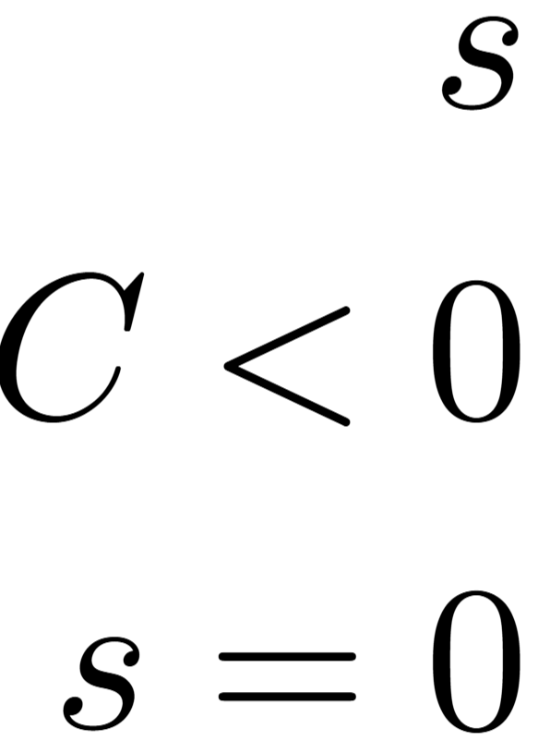
Startup company
N

Slide 71
Add noise to the chosen wage
Chosen

Slide 72
Add noise to the chosen wage
Chosen

Slide 73
Add noise to the chosen wage
Chosen

Slide 74
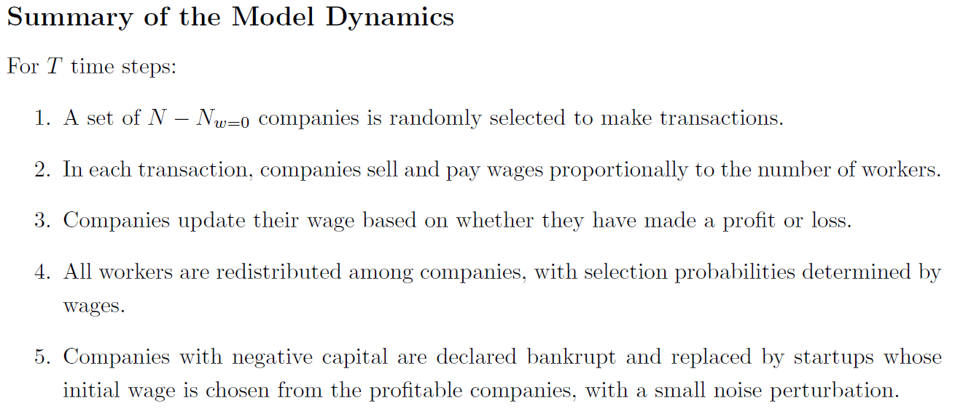
The complete picture

Slide 75
The complete picture

Slide 76
The complete picture

Slide 77
The complete picture

Slide 78
The complete picture

Slide 79
The complete picture
Model Dynamics

Slide 80
The complete picture
Parameters

Slide 81
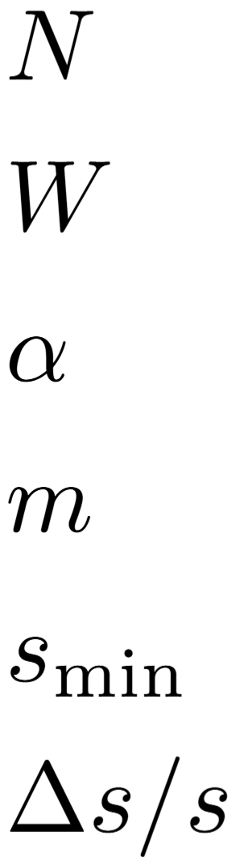
Parameters
: Number of companies.

Slide 82
Parameters
: Number of companies.
: Number of workers.

Slide 83
Parameters
: Number of companies.
: Number of workers.
: Worker’s sensitivity to wage differences.

Slide 84
Parameters
: Number of companies.
: Number of workers.
: Worker’s sensitivity to wage differences.

Slide 85
Parameters
: Number of companies.
: Number of workers.
: Worker’s sensitivity to wage differences.
: Noise magnitude on startup wages.

Slide 86
Parameters
: Number of companies.
: Number of workers.
: Worker’s sensitivity to wage differences.
: Noise magnitude on startup wages.
: Minimum wage.

Slide 87
Parameters
: Number of companies.
: Number of workers.
: Worker’s sensitivity to wage differences.
: Noise magnitude on startup wages.
: Minimum wage.
: Wage update size.

Slide 88

Parameters
: Number of companies.
: Number of workers.
: Worker’s sensitivity to wage differences.
: Noise magnitude on startup wages.
: Minimum wage.
: Wage update size.

Slide 89
Parameters
: Number of companies.
: Number of workers.
: Worker’s sensitivity to wage differences.
: Noise magnitude on startup wages.
: Minimum wage.
: Wage update size.

Slide 90
Results
Spoilers: This won't help you get rich on the stock market,
But it might inspire you to make simple economic models

Slide 91
How do we measure the market?
Time

Slide 92
How do we measure the market?
Time

Slide 93
How do we measure the market?
Time

Slide 94
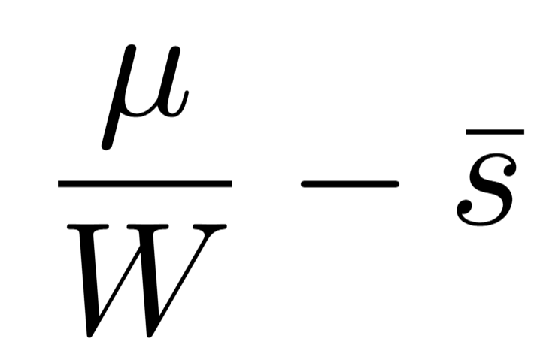
How do we measure the market?
Gain per worker
Average company’s loss per worker
= Average company’s profit per worker
Time

Slide 95
How do we measure the market?
Measures spread of workers i.e., company sizes
Time

Slide 96
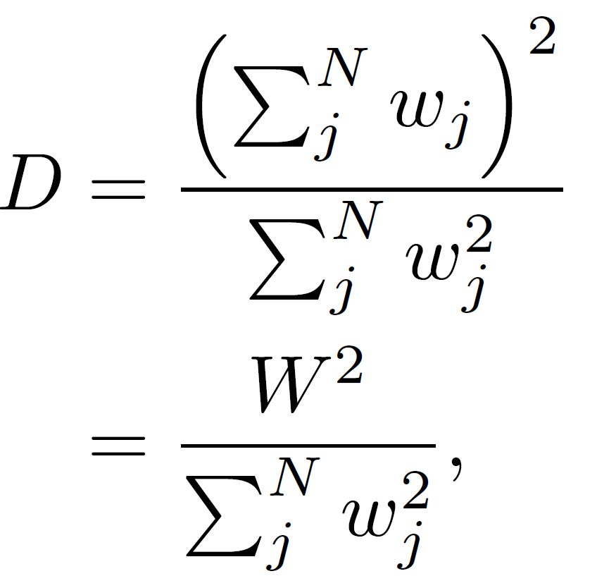
How do we measure the market?
Measures spread of workers i.e., company sizes
Time

Slide 97
How do we measure the market?
Measures spread of workers i.e., company sizes
Equally spread: D = N
All at one company: D = 1
Time

Slide 98
Phases in a cycle
Synchronized growth
Growing wages
High diversity
No bankruptcies
Positive but declining average profit
2. Unstable growth
Wage growth stopped
Declining diversity
Bankruptcies
Profits around swinging around zero
Time

Slide 99
Phases in a cycle
Synchronized growth
Growing wages
High diversity
No bankruptcies
Positive but declining average profit
2. Unstable growth
Wage growth stopped
Declining diversity
Bankruptcies
Profits around swinging around zero
Time

Slide 100
Phases in a cycle
Synchronized growth
Growing wages
High diversity
No bankruptcies
Positive but declining average profit
2. Unstable growth
Wage growth stopped
Declining diversity
Bankruptcies
Profits around swinging around zero
Time

Slide 101
Phases in a cycle
Synchronized growth
Growing wages
High diversity
No bankruptcies
Positive but declining average profit
2. Unstable growth
Wage growth stopped
Declining diversity
Bankruptcies
Profits around swinging around zero
Time

Slide 102
Phases in a cycle
Synchronized growth
Growing wages
High diversity
No bankruptcies
Positive but declining average profit
2. Unstable growth
Wage growth stopped
Declining diversity
Bankruptcies
Profits around swinging around zero
Time

Slide 103
Phases in a cycle
3. Mass bankruptcy (crash)
Declining wages
Low diversity
High number of bankruptcies
Low, but then huge profits
4. Startup growth
Startups guaranteed profits
Continues until all wages near average
Time

Slide 104
Phases in a cycle
3. Mass bankruptcy (crash)
Declining wages
Low diversity
High number of bankruptcies
Low, but then huge profits
4. Startup growth
Startups guaranteed profits
Continues until all wages near average
Time

Slide 105
Phases in a cycle
3. Mass bankruptcy (crash)
Declining wages
Low diversity
High number of bankruptcies
Low, but then huge profits
4. Startup growth
Startups guaranteed profits
Continues until all wages near average
Time

Slide 106
Phases in a cycle
3. Mass bankruptcy (crash)
Declining wages
Low diversity
High number of bankruptcies
Low, but then huge profits
4. Startup growth
Startups guaranteed profits
Continues until all wages near average i.e. high diversity
Time

Slide 107
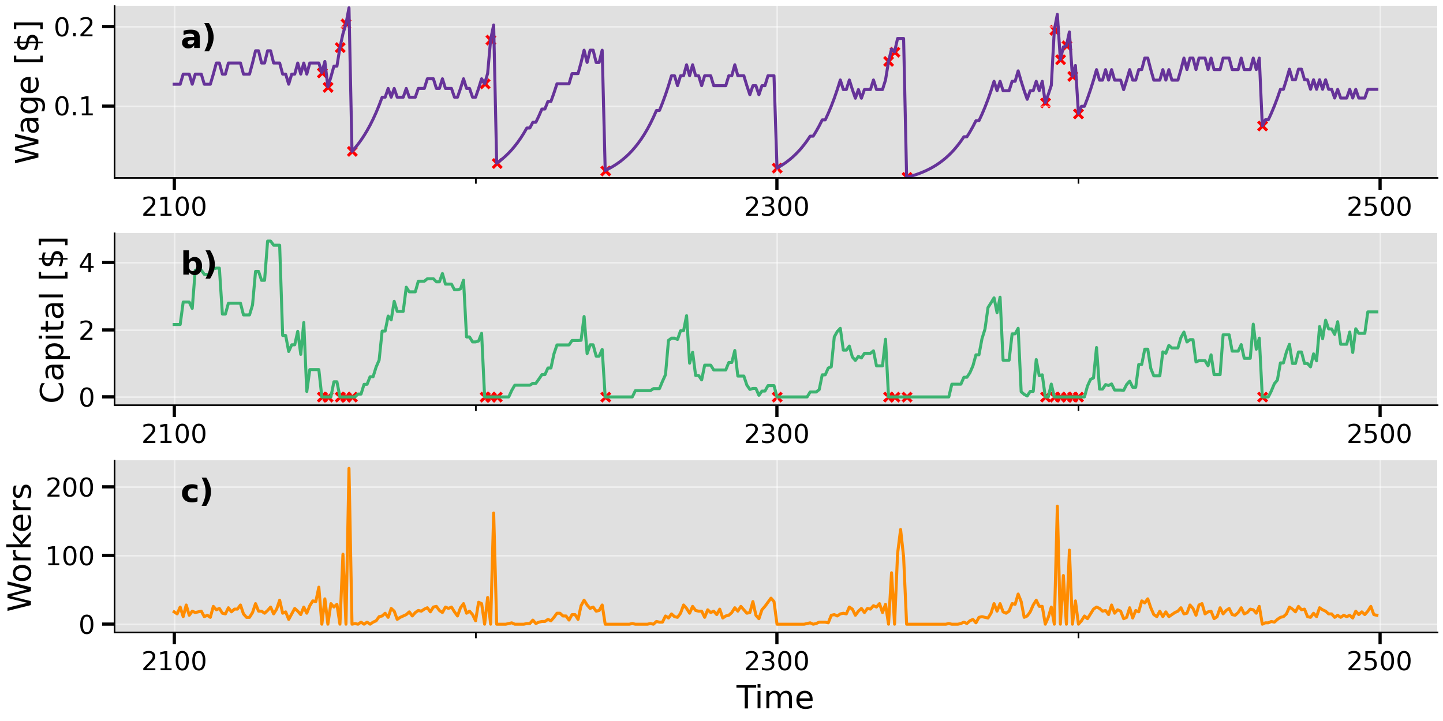
Single company trajectory

Slide 108
Single company trajectory

Slide 109
Comparison to data

Slide 110
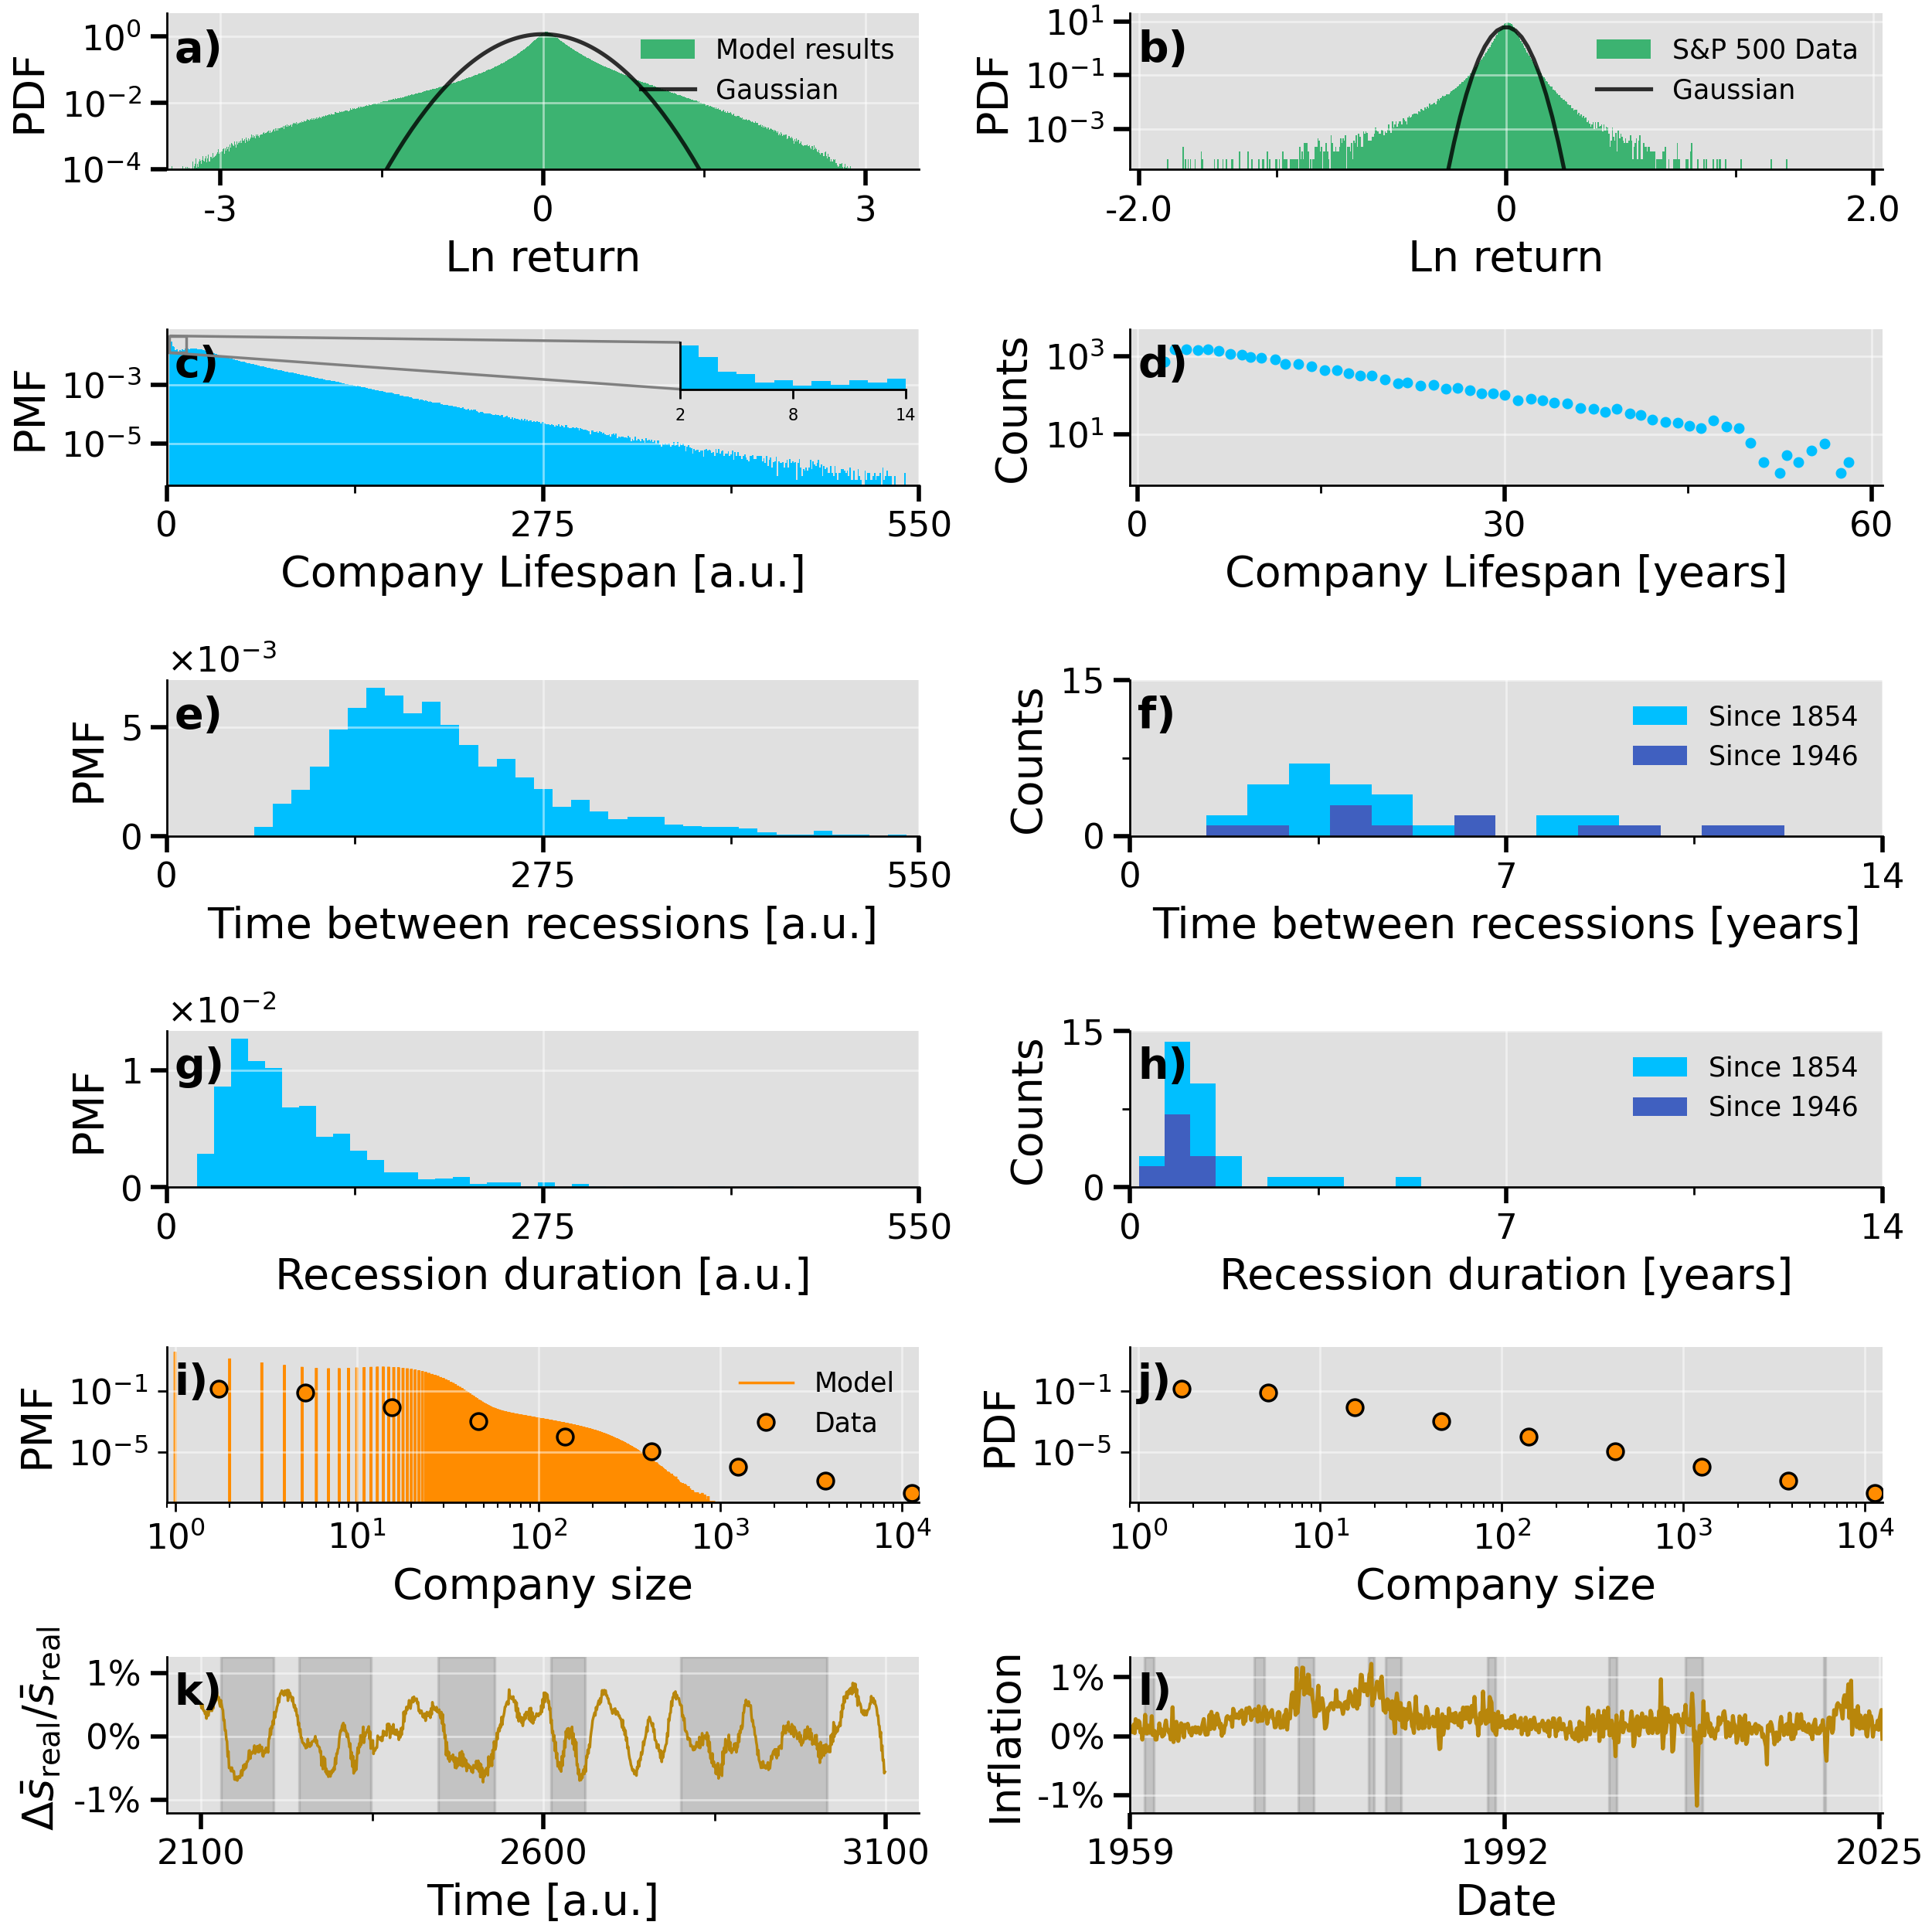
Comparison to data
Model
Data

Slide 111
Comparison to data
Model
Data
Qualitatively agreements:
Fat tails
Heavier left tail

Slide 112
Comparison to data
Model
Data
Exponential decay.
Set time scale of model.
But there is also a short time scale!

Slide 113
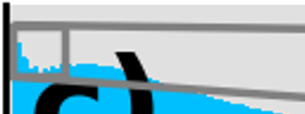
Comparison to data
Model
Data

Slide 114
Comparison to data
Model
Data

Slide 115
Comparison to data
Model
Data
Recession: Time from peak to trough

Slide 116
Comparison to data
Time peak-peak
Model
Data
Recession: Time from peak to trough

Slide 117
Comparison to data
Model
Data

Slide 118
Comparison to data
Model
Data
Not a good match ☹.
Peak at mean (W/N=20).
Does get more power-law like for higher .

Slide 119
Comparison to data
Model
Data
Model fluctuates around 0% (no growth)
Irregular but recuring cycles
Mean reversion
Inflation in good times, deflation/disinflation bad

Slide 120
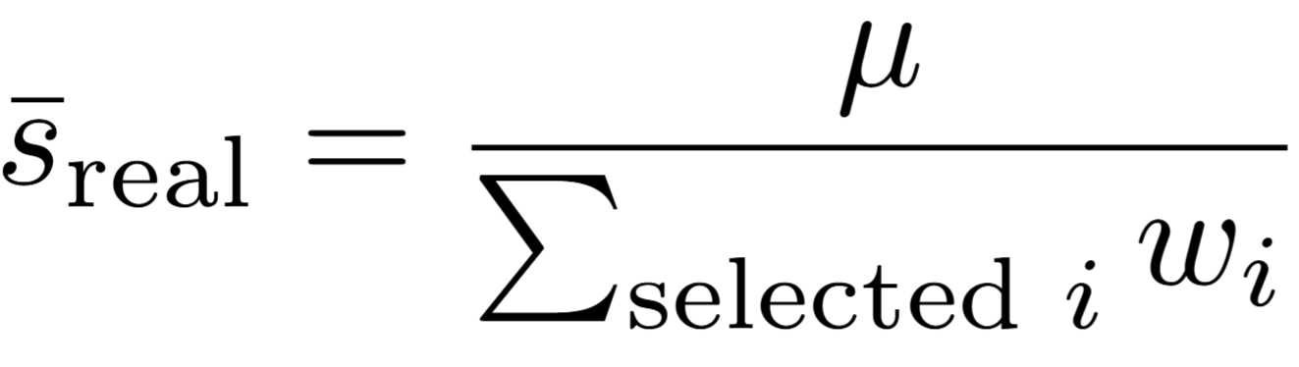
Comparison to data
Model
Data
Model fluctuates around 0% (no growth)
Irregular but recuring cycles
Mean reversion
Inflation in good times, deflation/disinflation bad

Slide 121
Comparison to data
Monthly inflation
Model
Data
Model fluctuates around 0% (no growth)
Irregular but recuring cycles
Mean reversion
Inflation in good times, deflation/disinflation bad

Slide 122
Comparison to data
Monthly inflation
Model
Data
Model fluctuates around 0% (no growth)
Irregular but recuring cycles
Mean reversion
Inflation in good times, deflation/disinflation bad

Slide 123
Comparison to data
Monthly inflation
Model
Data
Model fluctuates around 0% (no growth)
Irregular but recuring cycles
Mean reversion
Inflation in good times, deflation/disinflation bad

Slide 124
Comparison to data – Time scale

Slide 125
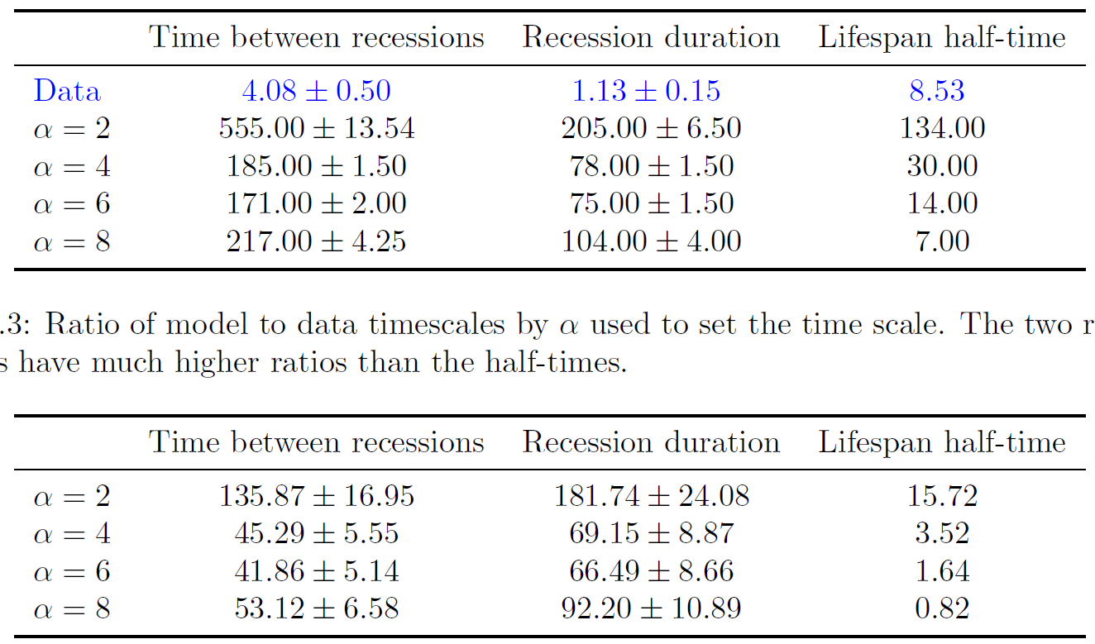
Comparison to data – Time scale
Medians of model and data
Time values

Slide 126
Comparison to data – Time scale
Medians of model and data
Time values
Ratio: model / data

Slide 127
Comparison to data – Time scale
Medians of model and data
Time values
Ratio: model / data
Roughly the same

Slide 128
Comparison to data – Time scale
Medians of model and data
Time values
Ratio: model / data
Roughly the same
… much smaller

Slide 129
Comparison to data – take away points
Qualitative agreements in most cases
We find non-periodic inflation-deflation cycles!
High company fragility and some micro weirdness

Slide 130
Parameter influence
: Number of companies.
: Number of workers.
: Worker’s sensitivity to wage differences.
: Noise magnitude on startup wages.
: Minimum wage.
: Wage update size.

Slide 131
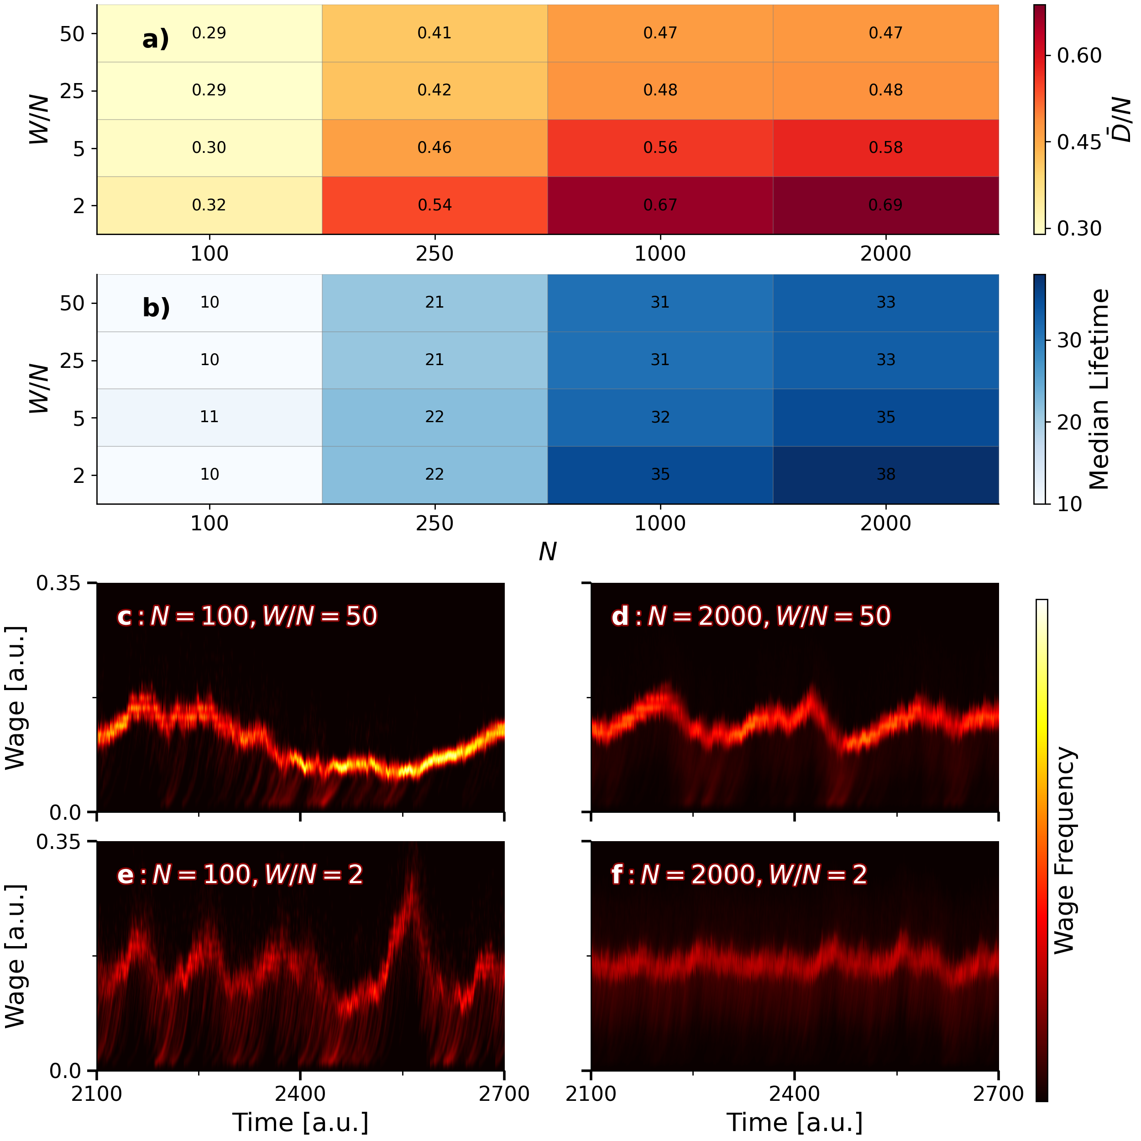
: Number of companies.
: Number of workers.
Average
diversity divided by N
N

Slide 132
: Number of companies.
: Number of workers.
Average
Diversity divided by N
N
Time

Slide 133
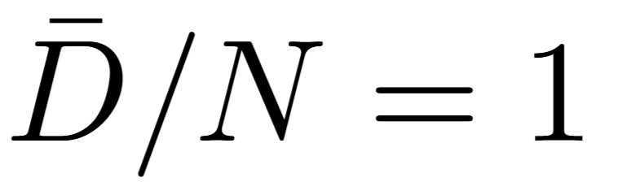
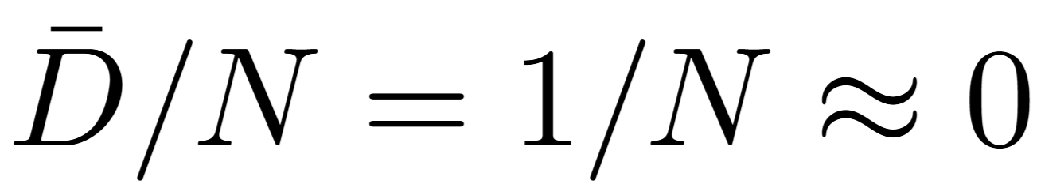
: Number of companies.
: Number of workers.
Average
Diversity divided by N
N
All workers equally spread:
All workers at one company:

Slide 134
: Number of companies.
: Number of workers.
Average
diversity
Lifespan

Slide 136
: Number of companies.
: Number of workers.

Slide 137
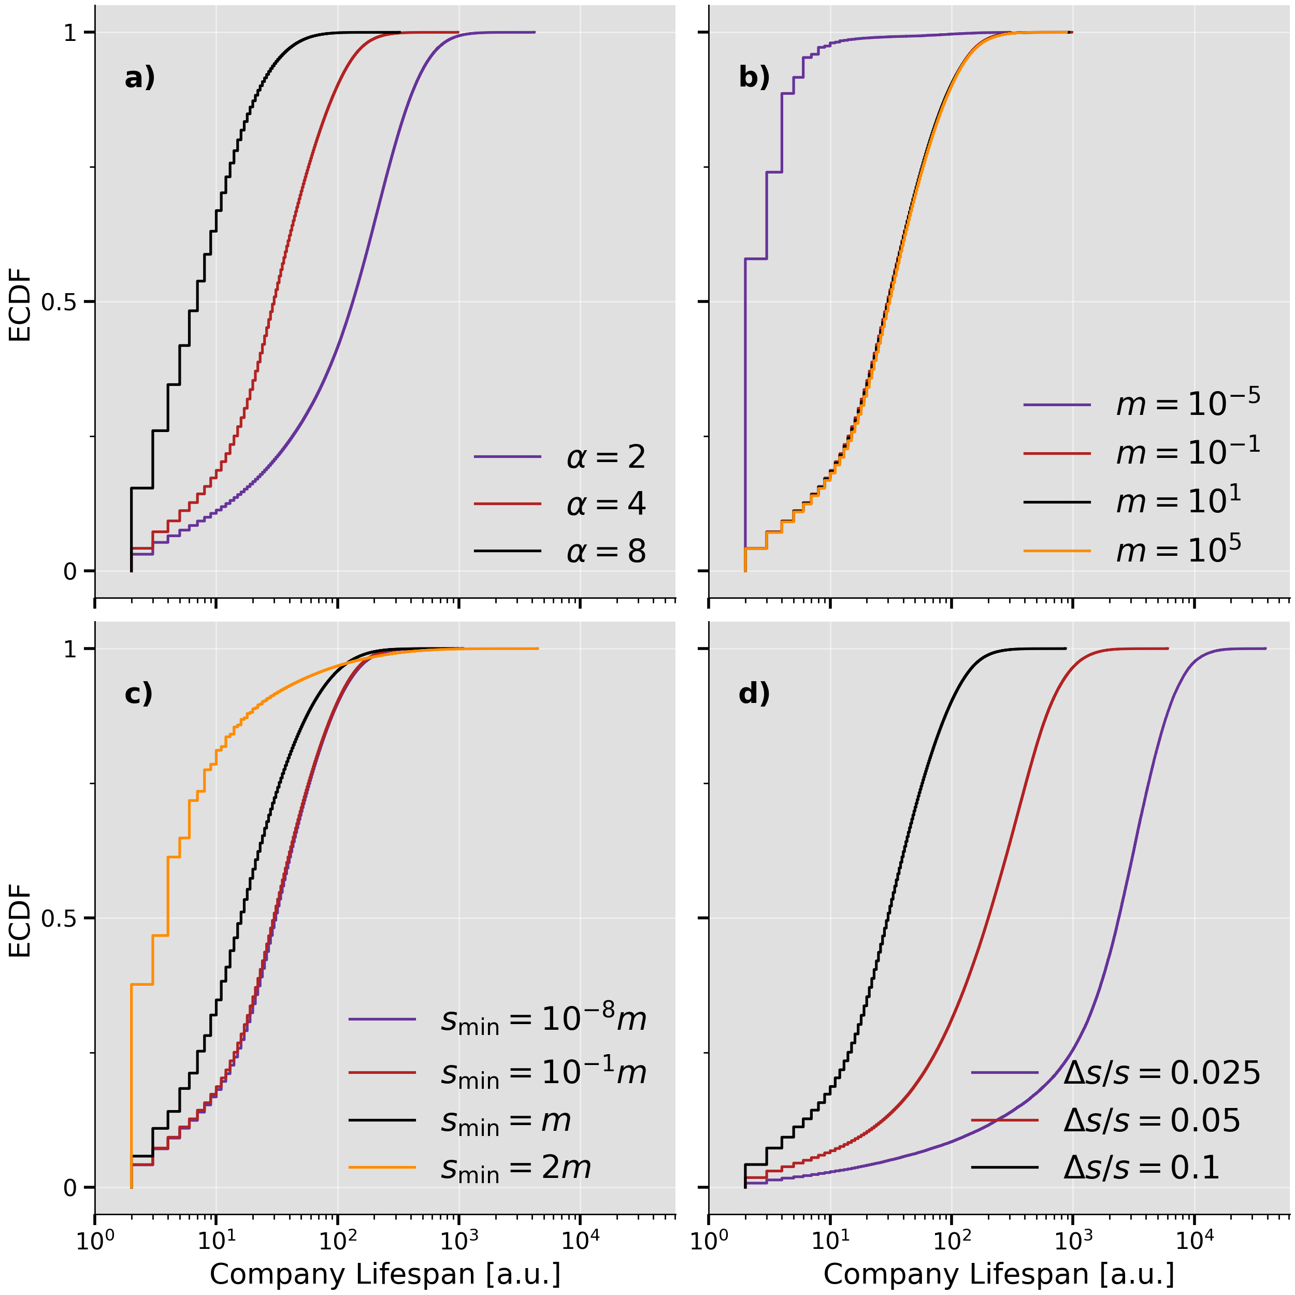
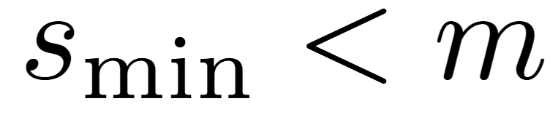
Cumulative distribution functions
A measure of fragility
: Increases fragility.
: No difference unless close to 0.
: Almost identical for
: A shift and higher individual deaths

Slide 138
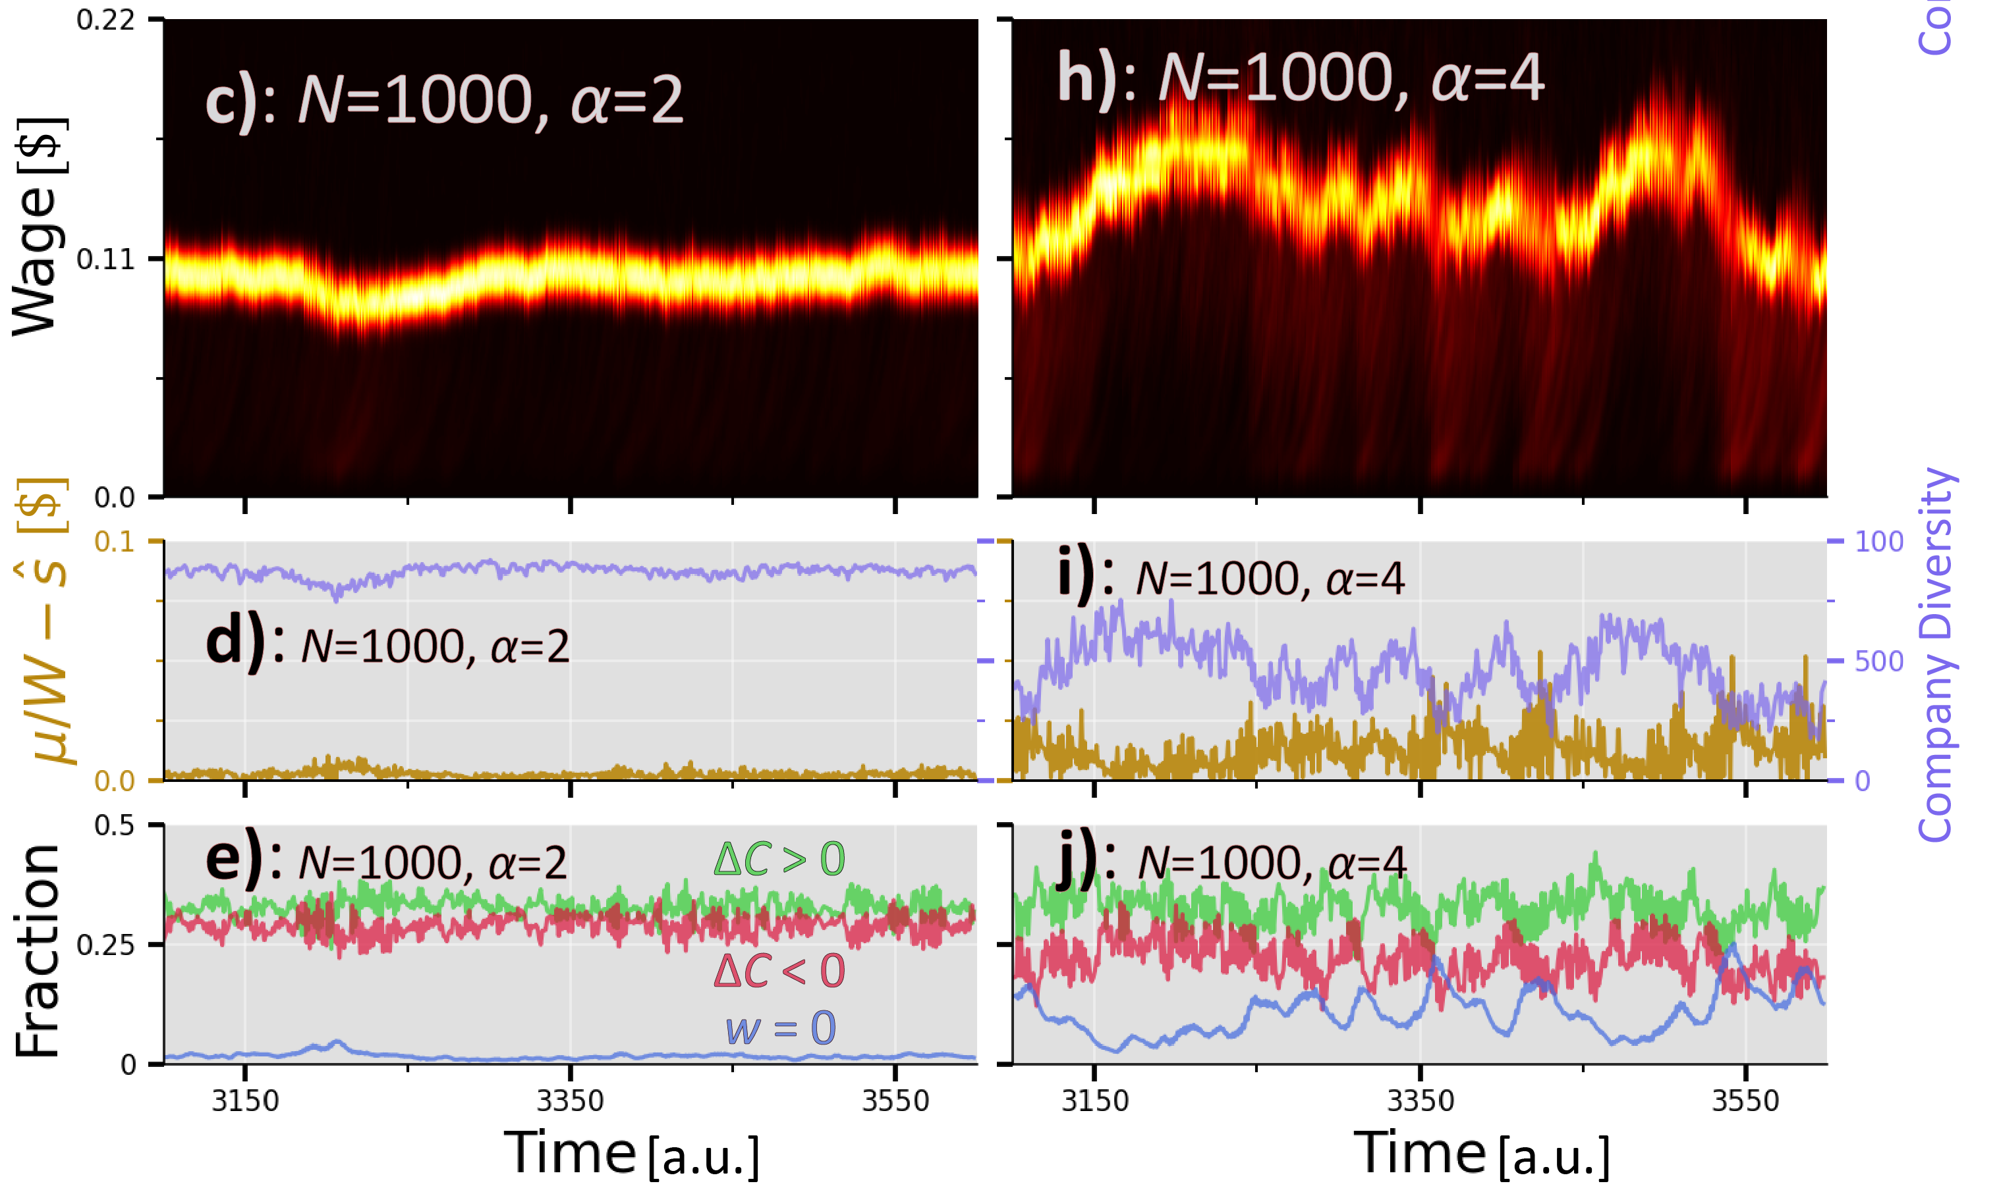
: Worker’s sensitivity to wage differences.

Slide 139
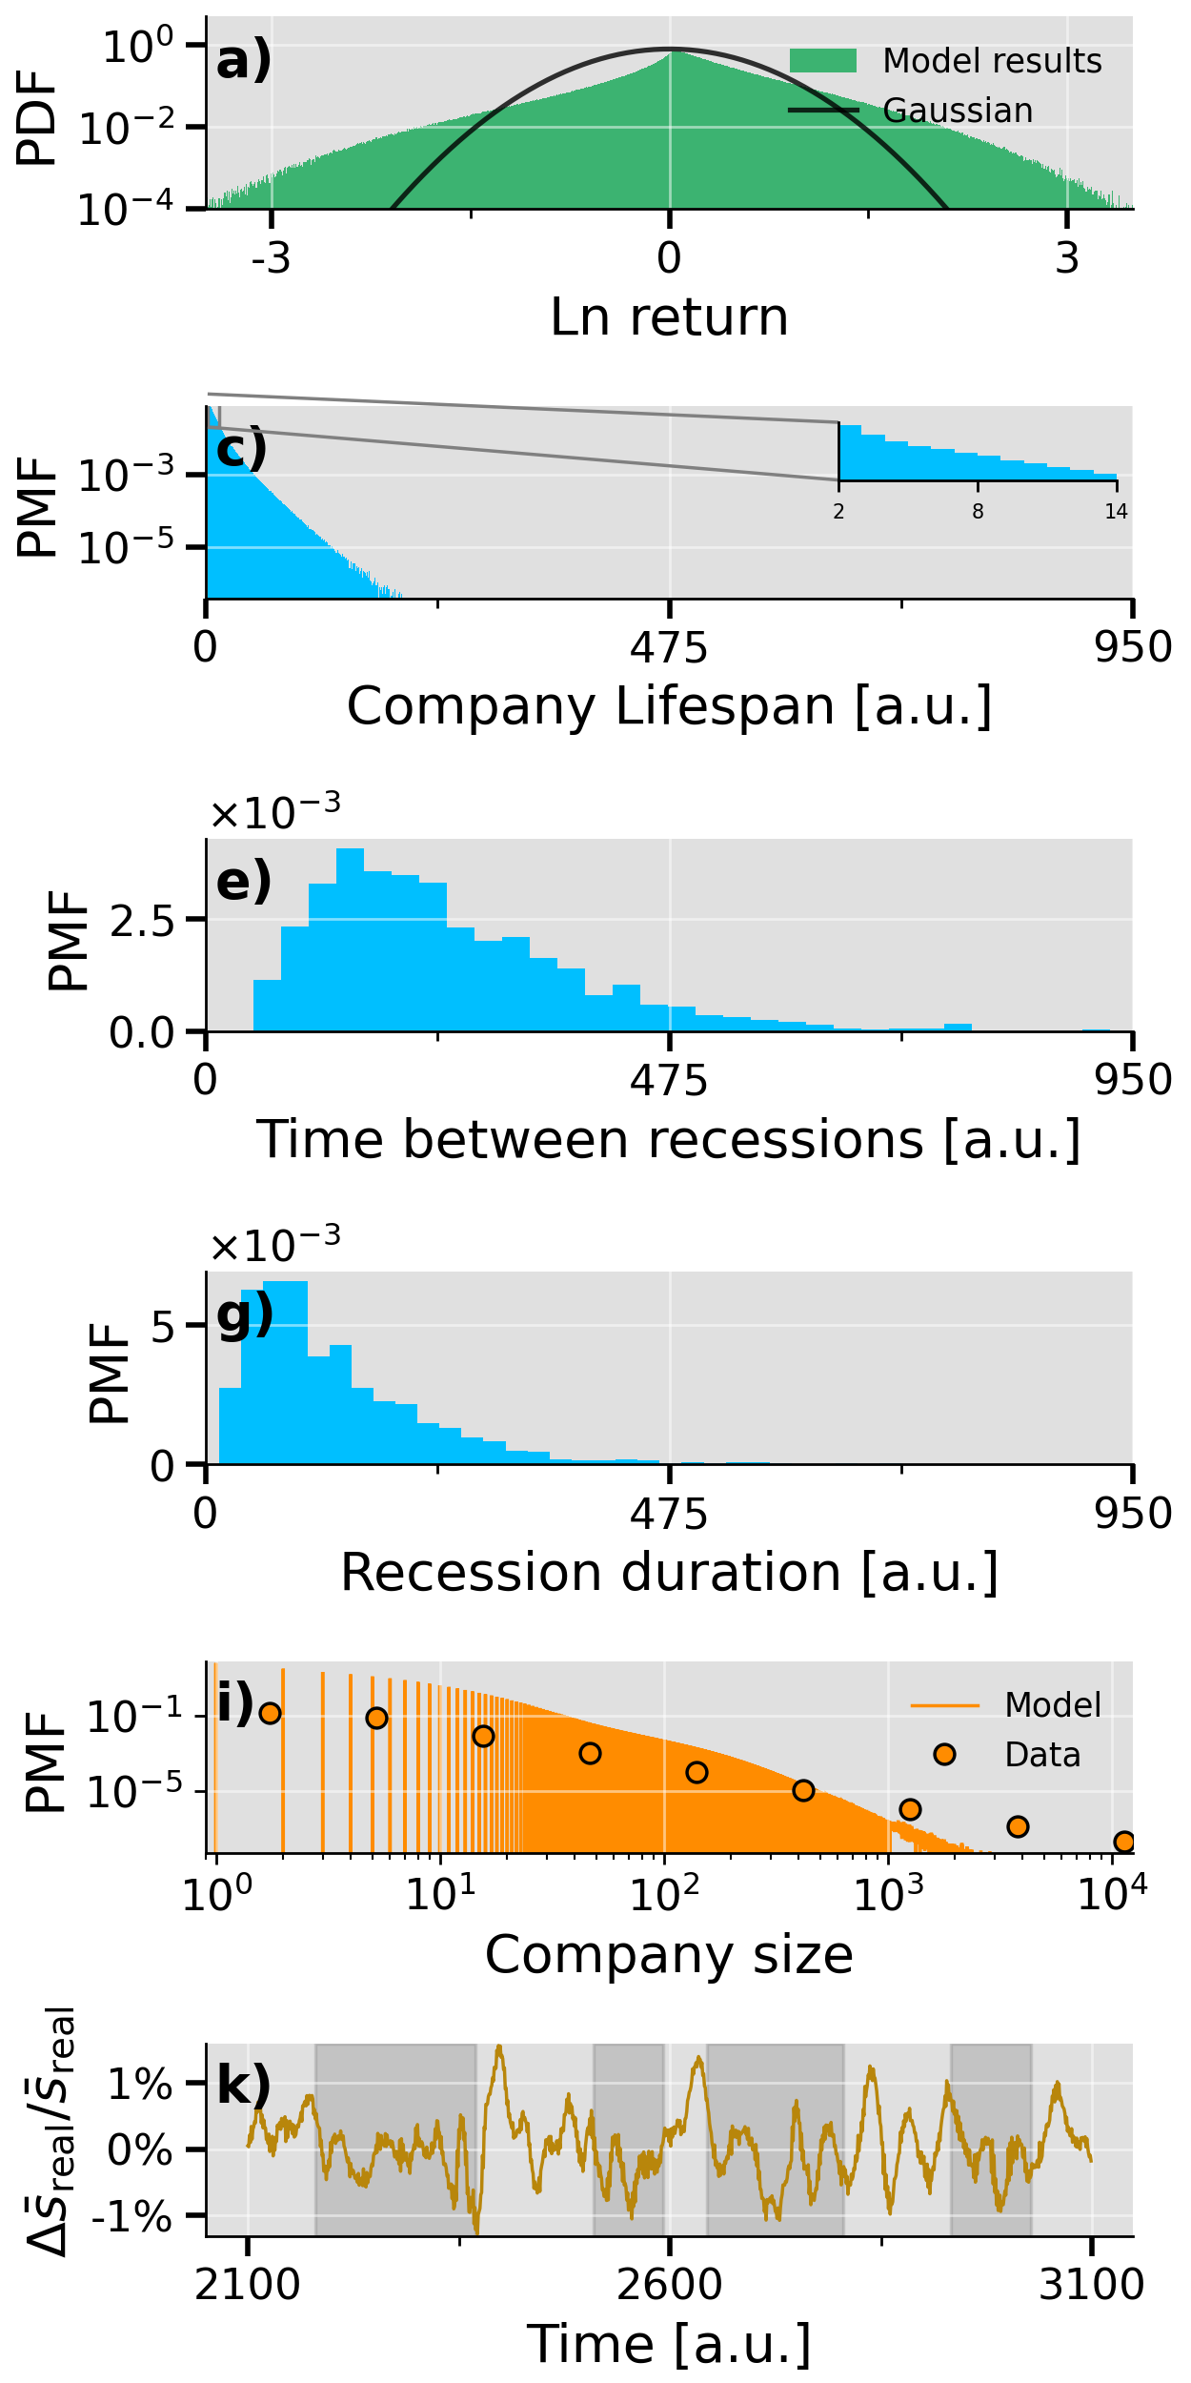
= 4
= 8

Slide 140
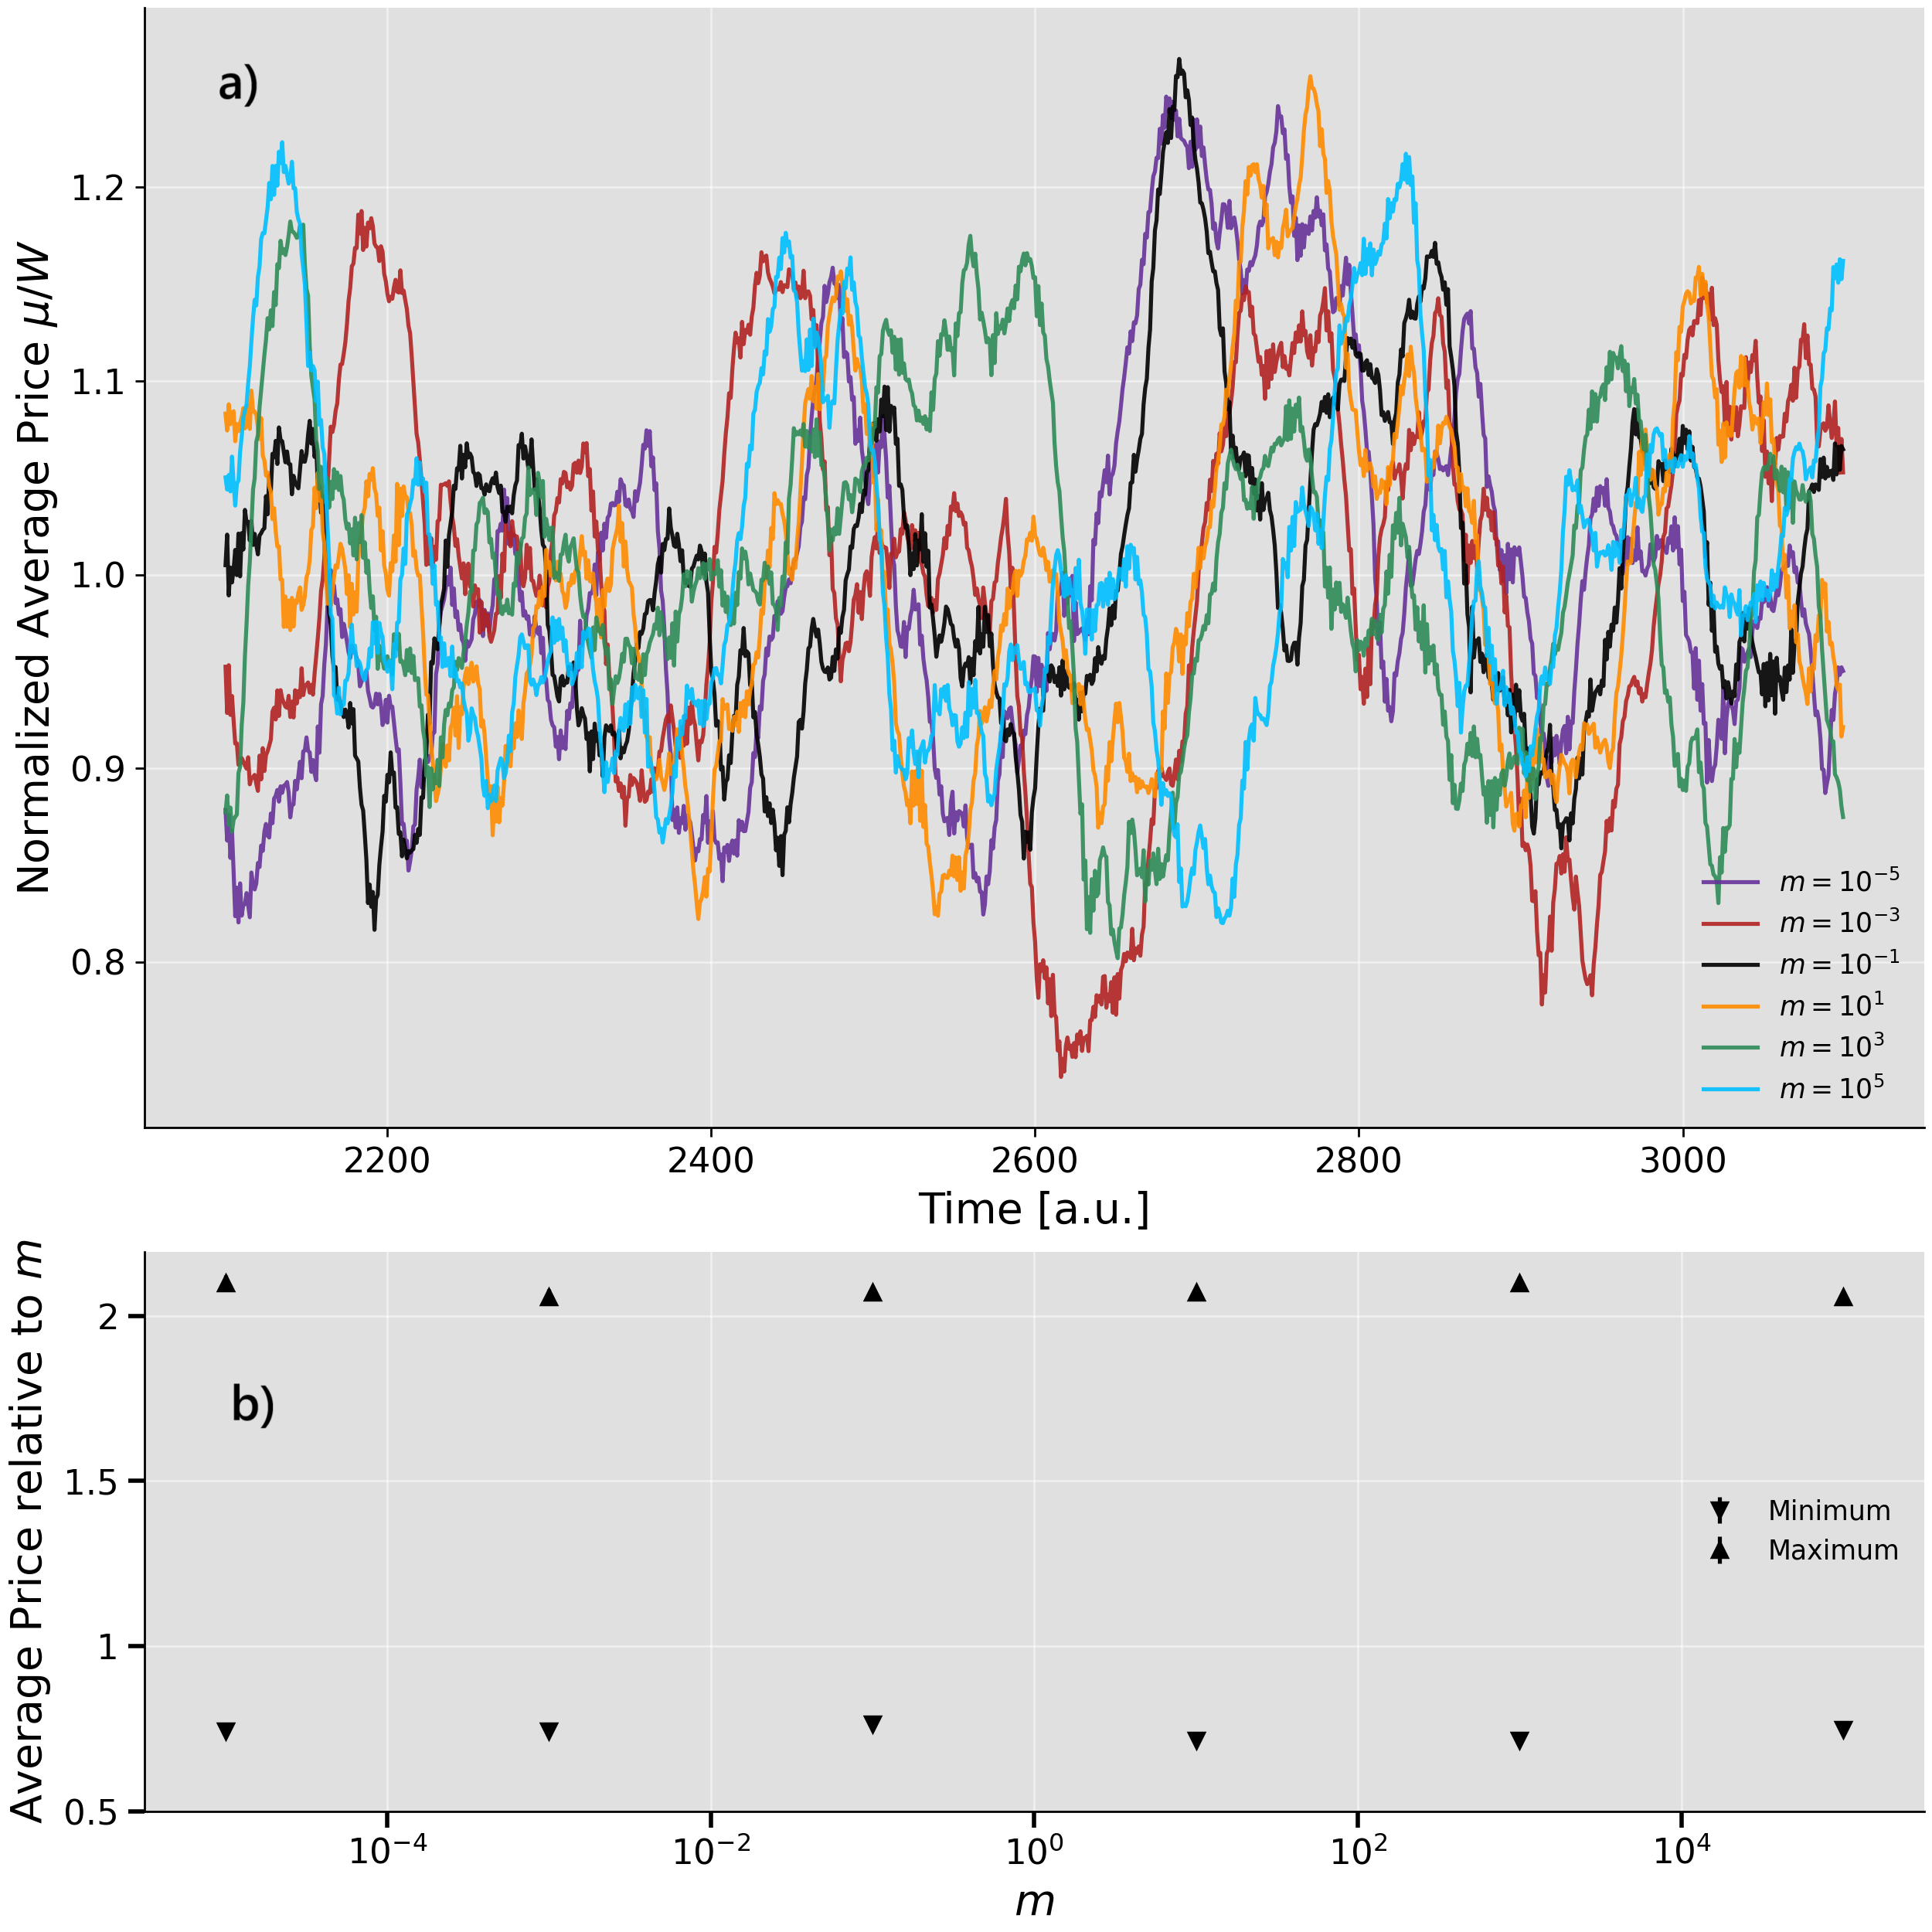
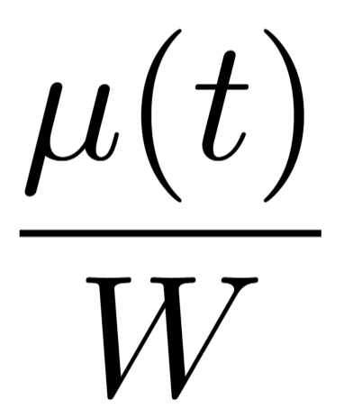
: Noise magnitude on startup wages.
What’s happening?
Take and normalize by the time-mean.
Repeat this for many .
Shows behavior is same for different .
Find the minima and maxima of and divide by .
Shows price scales linearly with .

Slide 141
: Noise magnitude on startup wages.
What’s happening?
Take and normalize by the time-mean.
Repeat this for many .
Shows behavior is same for different .
Find the minima and maxima of and divide by .
Shows price scales linearly with .

Slide 142
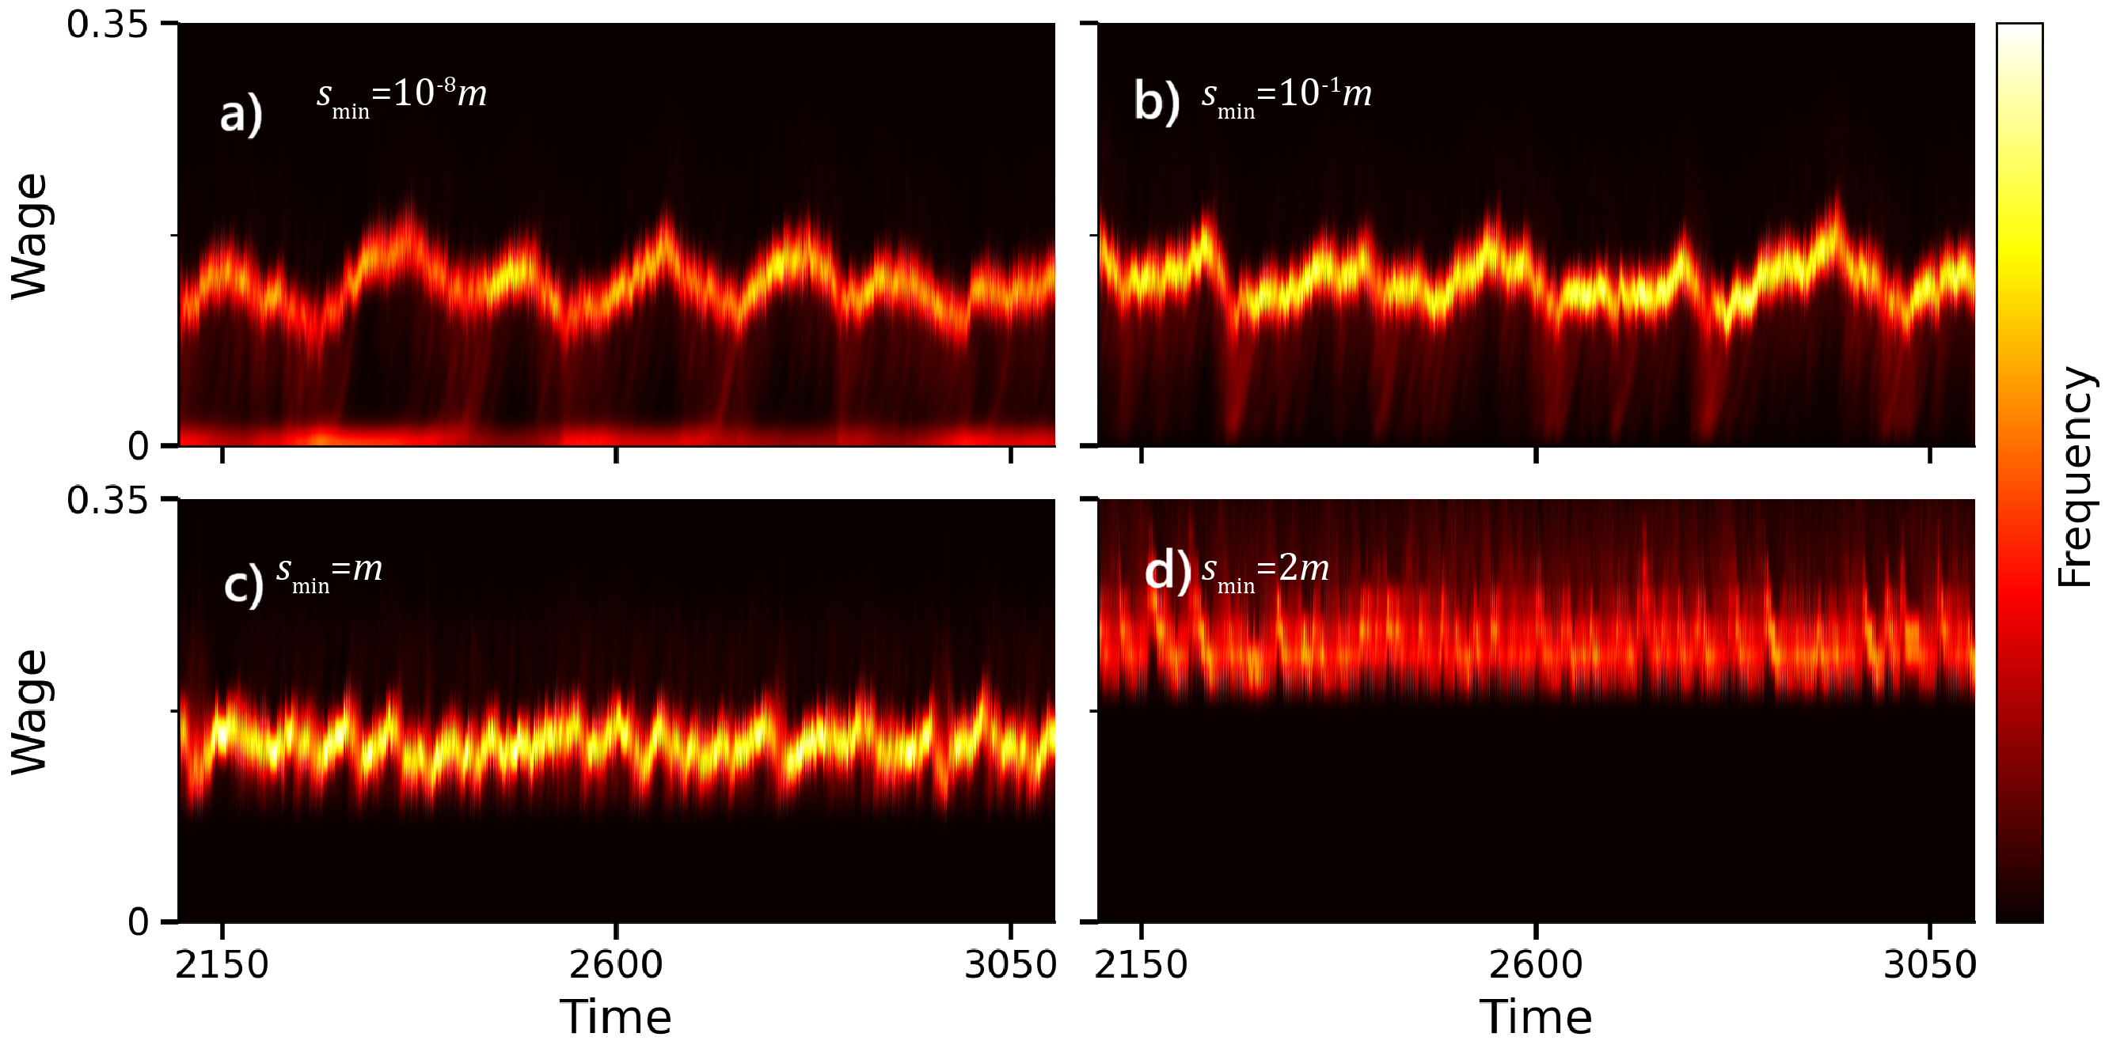
: Minimum wage

Slide 143

= 0.1
= 0.025

Slide 144
Parameter influence
: Number of companies. Low influence in non-extremes.
: Number of workers. Low influence in non-extremes.
: Worker’s sensitivity to wage differences. High influence on fragility and thus everything.
: Noise magnitude on startup wages. Sets the scale of prices (capital, wage).
: Minimum wage. Low influence in non-extremes.
: Wage update size. Sets the time scale and influences fragility at high values.

Slide 145
What causes cycles?
Buying Power (P)
Wages (s)
Roughly, and only on aggregate level
(The feedback is negative on a company level)

Slide 146

What causes cycles?
Wages and rise.
Large companies drive , but are also more vulnerable ( ).
A shock to occur when large companies are not chosen to transact, flipping the sign of the feedback loop
Average wage

Slide 147
What causes cycles?
Wages and rise.
Large companies drive , but are also more vulnerable ( ).
A shock to occur when large companies are not chosen to transact, flipping the sign of the feedback loop
Average wage

Slide 148
What causes cycles?
Wages and rise.
Large companies drive , but are also more vulnerable ( ).
A shock to occur when large companies are not chosen to transact, driving wages continually downwards
Average wage

Slide 149
What causes cycles?
Wages and rise.
Large companies drive , but are also more vulnerable ( ).
A shock to occur when large companies are not chosen to transact, driving wages continually downwards
Inflation
Deflation
Time

Slide 150
Conclusion
Pros
Replicated qualitative features of economic data.
6 < 18 (parameters).
Interpretability.
Extendable.
Cycles and shocks are endogenous (internal).

Slide 151
Conclusion
Pros
Replicated qualitative features of economic data.
6 < 18 (parameters).
Interpretability.
Extendable.
Cycles and shocks are endogenous (internal).
Cons
Limited use outside demonstration.
Some parameters seem redundant.
(Over-)simplified economics (no unemployment, fragility, non-sticky wages).

